Slide 1
JULIUS CAESAR BY WILLIAM SHAKESPEARE
Character List

Slide 2
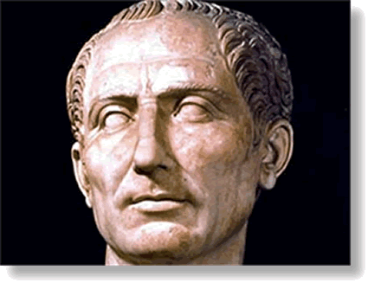
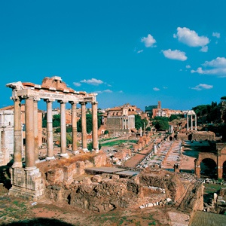
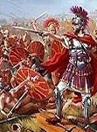
The Scene…
Based on a true story, this play takes
place in Ancient Rome,
where Julius Caesar
has just returned in
triumph from war.
The crowd hails him as their new leader, but there are some Romans who fear he will become too powerful of a ruler, more like an emperor, and they will lose the liberties they have enjoyed as citizens of a free state.

Slide 3
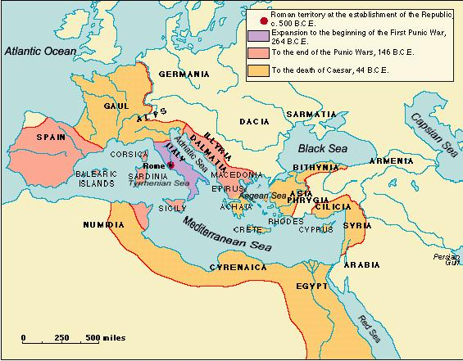
Republic!
A small group of men conspire to assassinate Caesar, believing they are acting to preserve the freedoms of the Roman Republic.

Slide 4
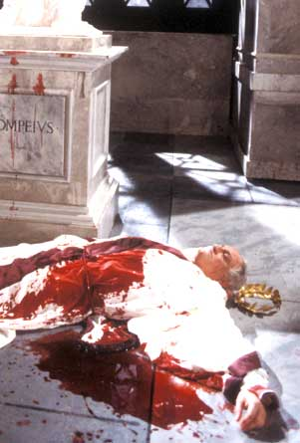
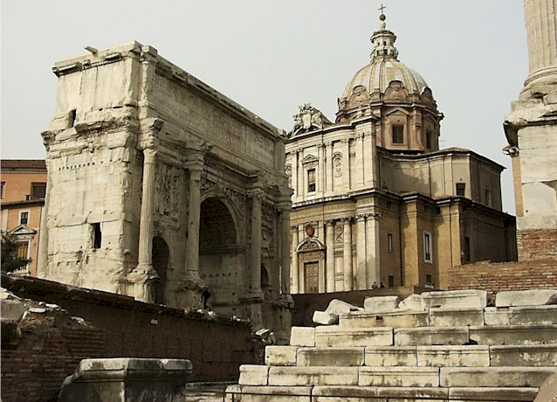
The Ides of March
Death of Caesar
They surround him in the Forum,
and stab him to death.

Slide 5
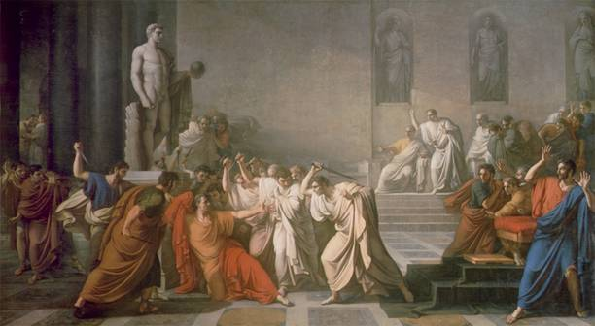
Consequence
The play goes on to tell the story of what happens after the murder, as the conspirators quarrel among themselves, war erupts, and liberties, instead of being protected, appear to be lost.

Slide 6
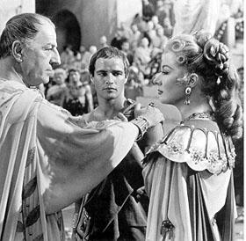
Julius Caesar
He is the head of the Roman state. He is a great soldier, and has just returned from a series of wars during which he defeated the sons of the previous Roman ruler, Pompey.
He is popular with the crowds that stand in the streets to greet his triumphal return, cheering and clapping. Calpurnia is Caesar’s wife.

Slide 7
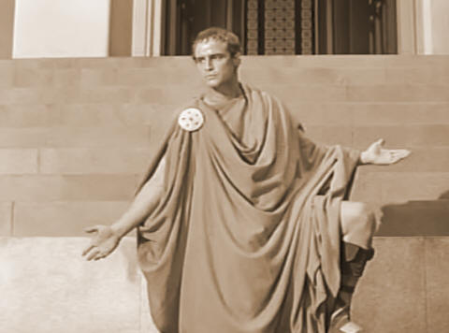
Mark Antony
He is a loyal friend and supporter of Caesar, who he believes will make a good ruler of Rome. He is appalled at the killing of the head of state, and although he shakes hands with the conspirators immediately after the murder, he vows to avenge Caesar’s death.
He gives a funeral oration over Caesar’s dead
body that stirs the crowd to anger and
desire for revenge. He will be one of the
three rulers of Rome, after Caesar’s death,
and he gathers an army to fight the killers.

Slide 8
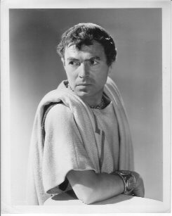
Brutus
He is a respected Roman, a man of intelligence and honor, who is a personal friend of Caesar, yet wonders whether, as a ruler, he will overstep his powers and become a tyrant rather than a good head of state.
He is finally convinced to join the conspirators as their leader. As they raise their daggers to commit the murder, Caesar recognizes his dear friend and cries, in Latin, “Et tu, Brute?” or “You too, Brutus?” Portia is Brutus’ wife.

Slide 9
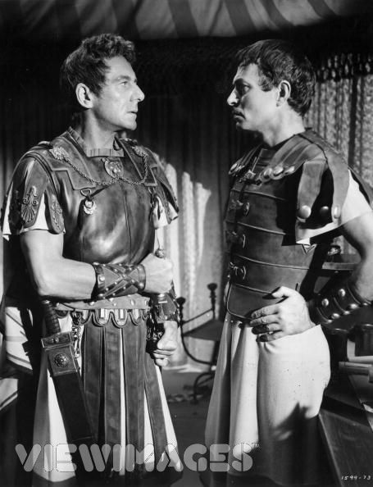
Cassius
Cassius is one of the leaders of the conspiracy. He is suspicious of Caesar from the beginning, gathers others into the band, and convinces Brutus to join with them in their plans for assassination.
He and Brutus flee Rome after the killing, each gathers an army, and they try to conquer Mark Antony’s army.

Slide 10
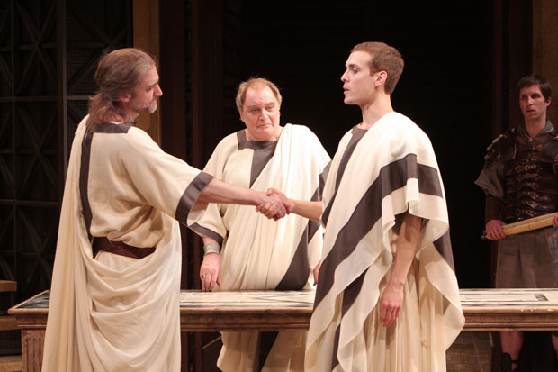
Octavius and Lepidus are the other two who join with Mark Antony after Caesar’s death to rule Rome as a triumvirate.

Slide 11
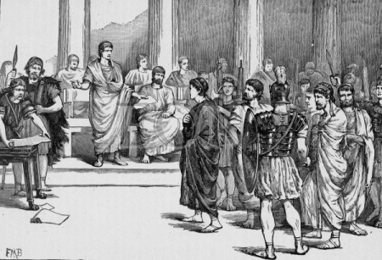
Show me your friends...
Casca, Trebonious,
Decius, Cinna
and Metallus
Cimber are the
other members of
the conspiracy,
each of whom
participates
by stabbing Caesar.

