Slide 1
Intro to Sophocles and Antigone

Slide 2
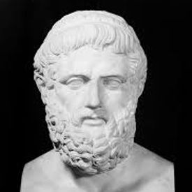
Sophocles
Sophocles was born in Colonus, a small town outside of Athens, Greece in 495 B.C.
Middle class upbringing
Polytheistic
Believed in multiple gods, each one with his/her own purpose
Gods lived on Mt. Olympus
Led by Zeus
He was a busy and accomplished man
Award-winning playwright
Army General
Negotiator during war
Priest

Slide 3
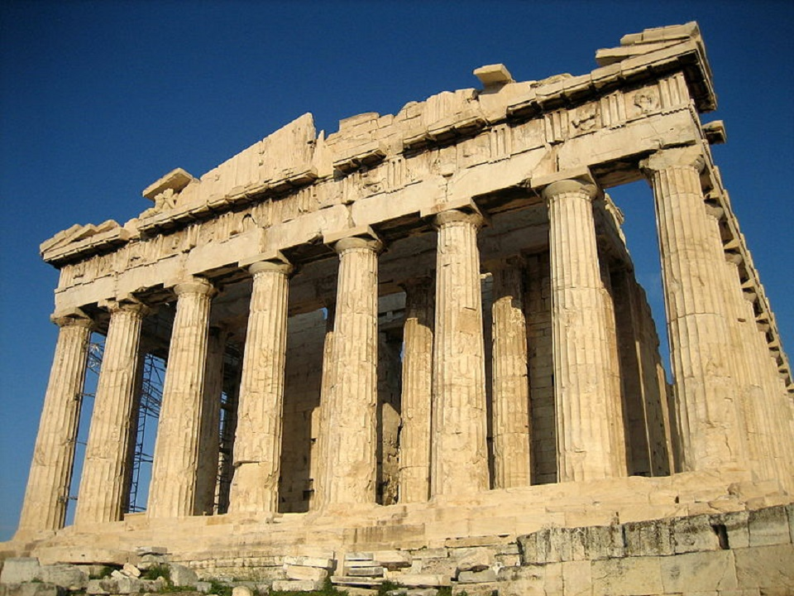
The Golden Age
Sophocles lived in the “Golden Age”
the Classical period (500-300 B.C.)
Began with the unlikely defeat of the Persians
Ended with the Peloponnesian War between Athens and Sparta
Resulted in some of the greatest monuments, art, philosophy, architecture, and literature which became the building blocks for Western society
Homer’s The Iliad and The Odyssey
The Parthenon
Democracy instead of tyranny

Slide 4
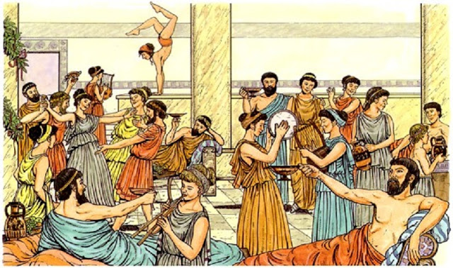
The Festival of Dionysus (Dionysia)
Dionysus – the Greek god of wine, ecstasy, madness, and theater
aka the Party God
The Festival of Dionysus was originally a religious ceremony in honor of Dionysus, and the people celebrated through theatrical performances
The festival also included a competition to see which playwright could write the best tetralogy
A tetralogy (tetra=four) consisted of three tragic plays and one satirical play

Slide 5
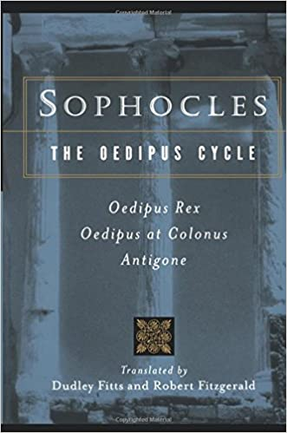
Sophocles as Playwright
Sophocles’s first public recognition as a playwright came when he won first prize at the festival in 468 B.C.
As the years continued, Sophocles went on to win first prize for his plays a total of 24 times
Since each tetralogy consisted of four plays, that means he wrote 96 first place award-winning plays
The Oedipus Cycle—consisting of the plays Oedipus Rex, Oedipus at Colonus, and Antigone—was one of these award winning tetralogies
Unfortunately, the 4th satirical play did not survive
Of over 100 plays he wrote, only seven still survive today
Sophocles also wrote poetry

Slide 6
Sophocles’s Other Interests
He was involved at the civic level
He served as a general under Pericles in the army
Pericles was largely responsible for the full development of the Athenian democracy and Athenian empire
Sophocles was a key negotiator in the Peloponnesian War
War between Athens and Sparta
As a priest, he was concerned with the individual’s need to find his/her own place in the moral and cosmic order of the universe
These views found their way into his plays, which contain moral lessons that usually pertain to man’s duty to the gods and the avoidance of excessive pride

Slide 7
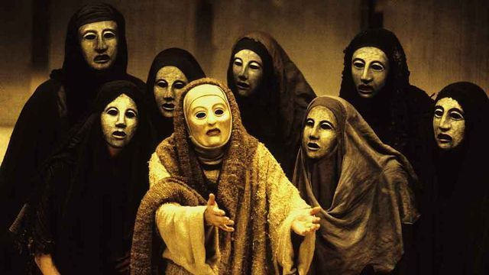
Some Background on Ancient Greek Theater
The Role of the Chorus in Greek Drama
A group of people who describe and comment on the main action of the play
Usually done through song, dance, and/or recitation
The group speaks as one
Also used to foreshadow what’s coming, recap what’s happened, and/or tell the audience how they should be feeling
The Makeup of the Chorus
An actual choir of people who weren’t actors
They were non-professionals who had a talent for singing and dancing
They were trained by the poet/playwright in preparation for the performance
The standard number of members in a chorus started at 12, but Sophocles raised it to 15

Slide 8
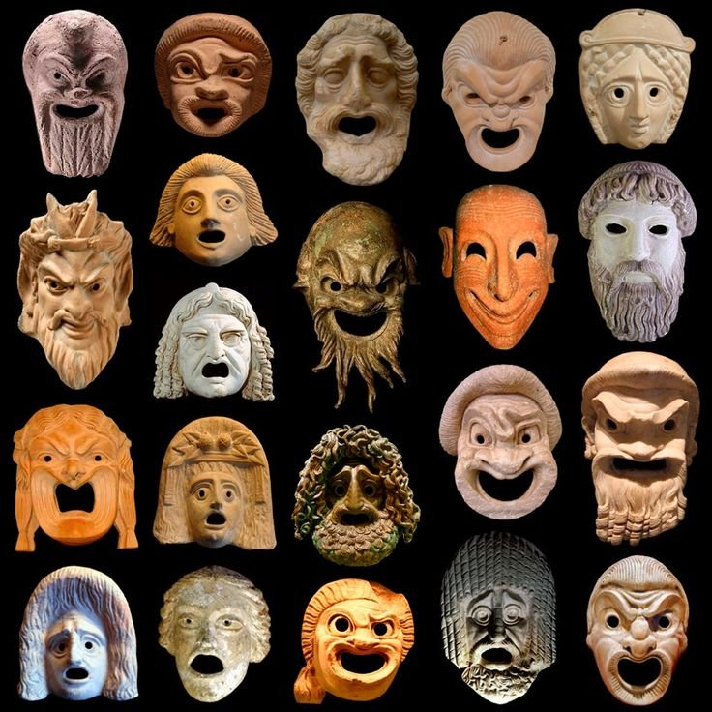
Some Background on Ancient Greek Theater
Thespis – accredited as the “inventor of tragedy,” and he introduced the concept of individual actors by speaking directly to the chorus leader
Also introduced the idea of using masks, makeup, and costumes so an actor could play several roles
These contributions are why actors today are called “thespians”
Aeschylus – accredited as the man who increased the number of actors from one to two and reduced the role of the chorus, putting emphasis on dialogue between characters

Slide 9
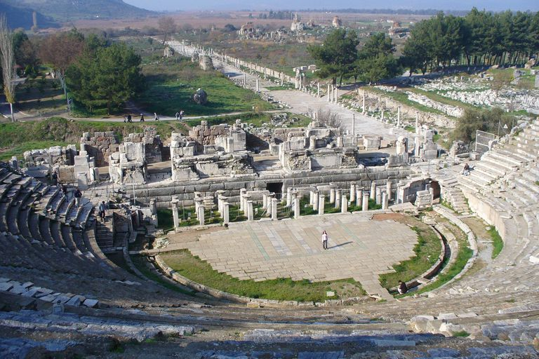
Greek Theater
Open-air amphitheater
Due to lack of artificial lighting, performances took place during the day
Greek Tragedy
Action usually takes place in front of palaces, temples, or other outdoor settings
The hero suffers a serious misfortune which is not accidental
The misfortune is logically connected with the hero’s actions
Tragedy stresses the vulnerability of human beings whose suffering is brought on by a combination of human and divine actions

Slide 10
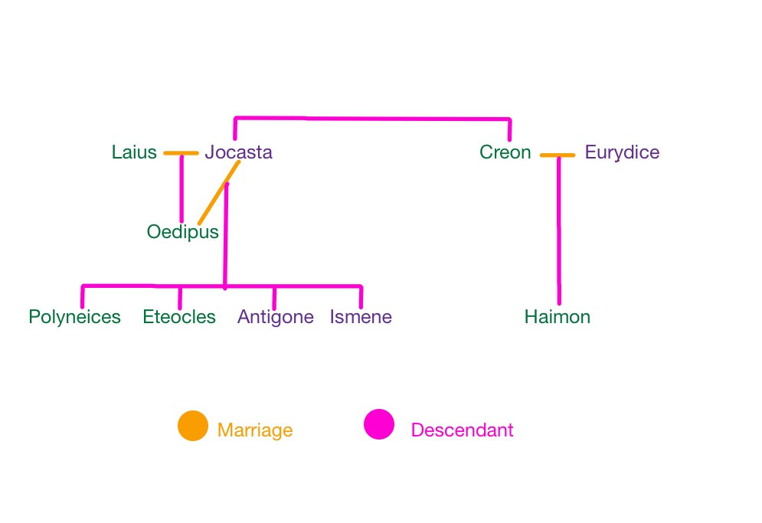
Antigone Family Tree

Slide 11
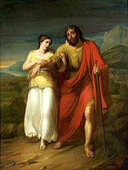
Antigone Background
The third play in the existing trilogy that recounts the story of Oedipus
What You Need to Know Before We Start Reading
After Oedipus is exiled from Thebes, his daughters accompany him to care for him as he wanders around the wilderness for years
During this time, Polynices and Eteocles become of age and decide the share the throne; each will rule for a year at a time, taking turns
One year, Eteocles bribes his men to turn against Polynices and refuses to give up the throne at the end of his term
Polynices goes to the city of Argos to raise an army to fight against his own brother and regain the throne

Slide 12
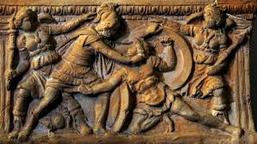
Antigone Background Continued
Continued:
The war is waged, and the brothers kill each other
During this time, Oedipus dies of old age, and Antigone and Ismene begin making their way back home to Thebes
By the time they arrive, their brothers are dead, and Creon is now king
Creon decrees that Eteocles should be given a hero’s burial while Polynices is treated like a traitor – his body is left outside the city to rot and be eaten by wild animals

Slide 13
Parts of the Play
Prologue – gives relevant background, often based on mythology
Parados – first song of the chorus
Episodes (Scenes) – literally translates to “between odes;” where the main action and dialogue of the play occurs
Ode – at the end of each episode/scene, the actors leave the stage, and the chorus dances and sings a choral ode that summarizes the episode
Most of the play alternates between episodes and odes until the final scene
Paean – a song of praise or triumph
Exodos – when the chorus exits singing a processional song which usually offers words of wisdom related to the play

Slide 14
Terms You Need to Know
Oracle – a priest or priestess who could deliver messages from the gods to mortals in exchange for a sacrificial offering made to the gods
Common sacrifices could include animals like cattle or goats, or other offerings such as wine, milk, oil, or honey
Choragus – chorus leader
Soothsayer – another term for prophet
The Furies – goddesses of vengeance and justice who plagued and punished men for their crimes
Tragic Hero – protagonist who usually dies due to some tragic flaw
Hamartia/Tragic Flaw – a flaw that leads to the downfall of a tragic hero
Hubris – excessive pride; a common tragic flaw

