Slide 1
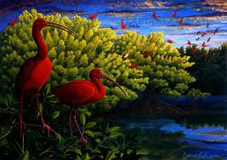
Scarlet Ibis in Mangrove Tree at Sunset
Edward Rooks

