Slide 1
Color Symbolism

Slide 2
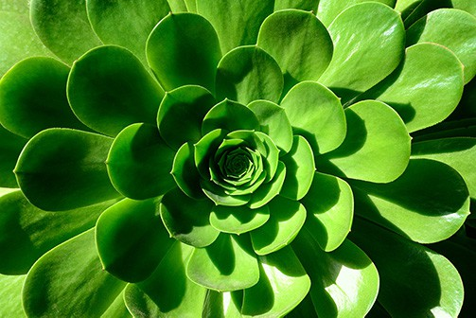
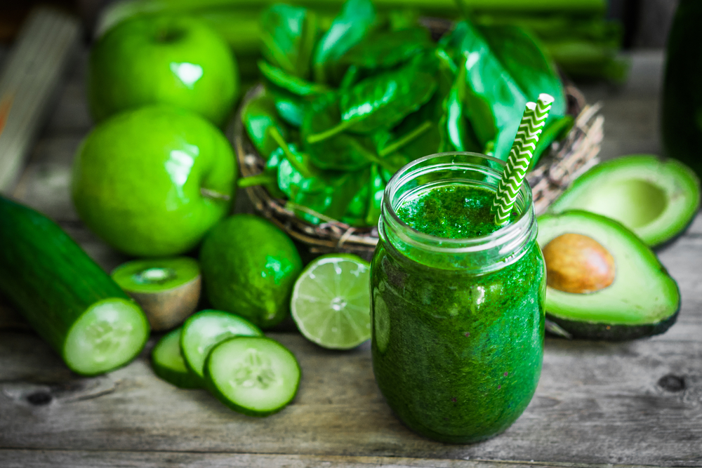
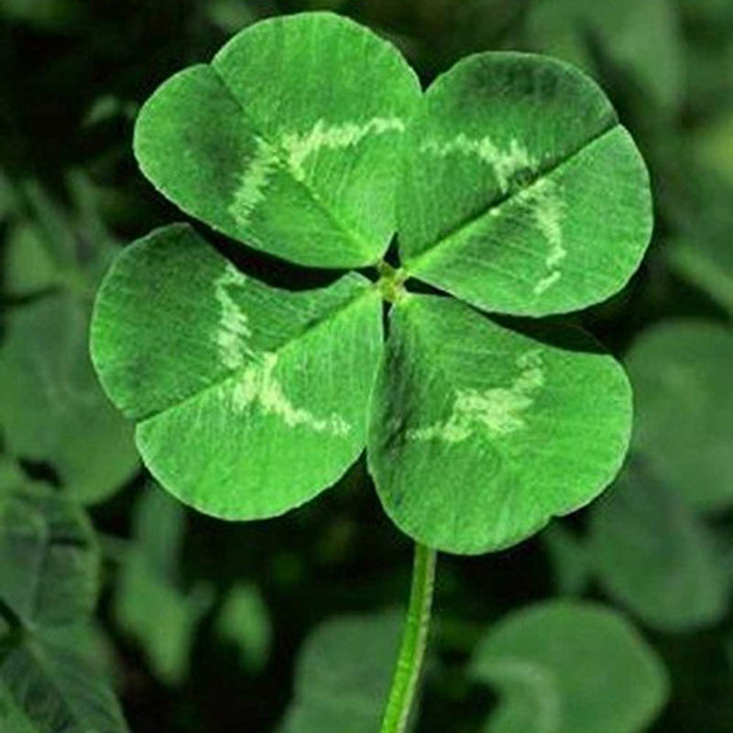
Nature, environment, health, well-being, good luck, renewal, youth, spring, generosity, wealth, jealousy, inexperience, envy, balance

Slide 3
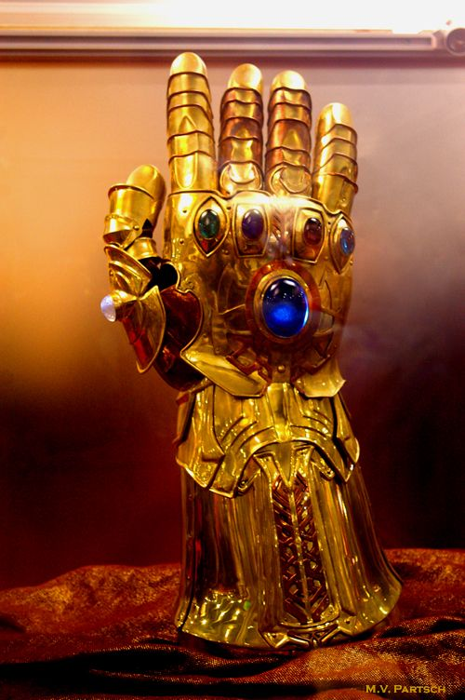
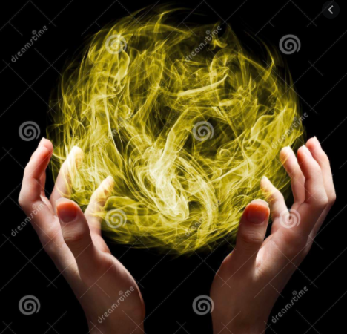
Wealth, luxury, power, optimism, hope, courage, magic, wisdom, achievement, success

Slide 4
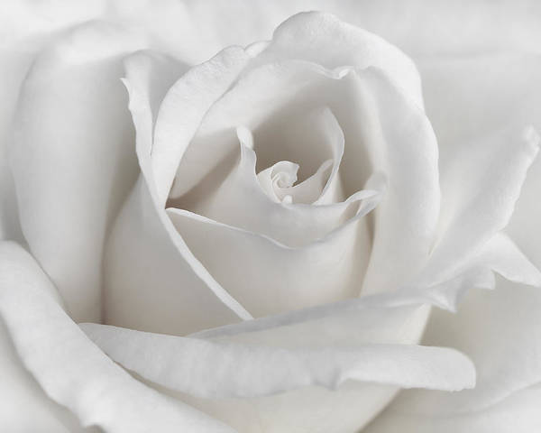
Purity, birth, simplicity, cleanliness, peace, innocence, youth, good, cold, clinical

Slide 5
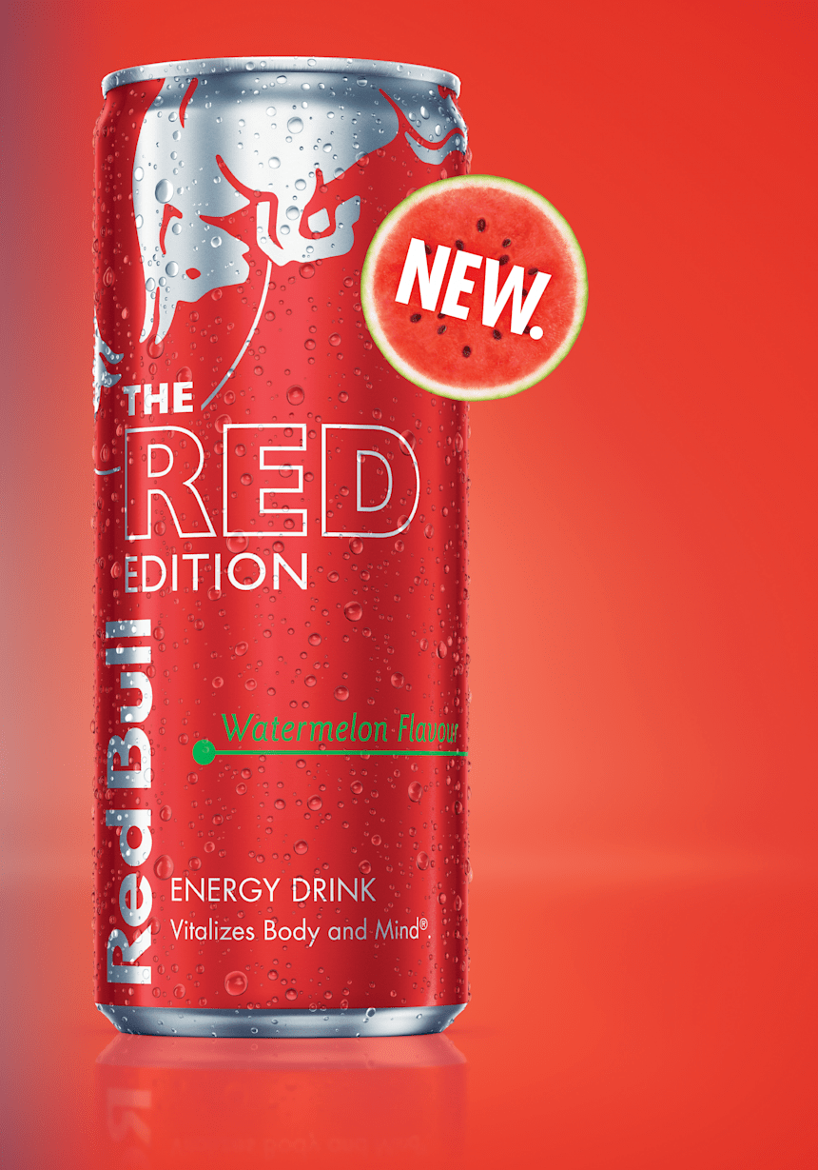
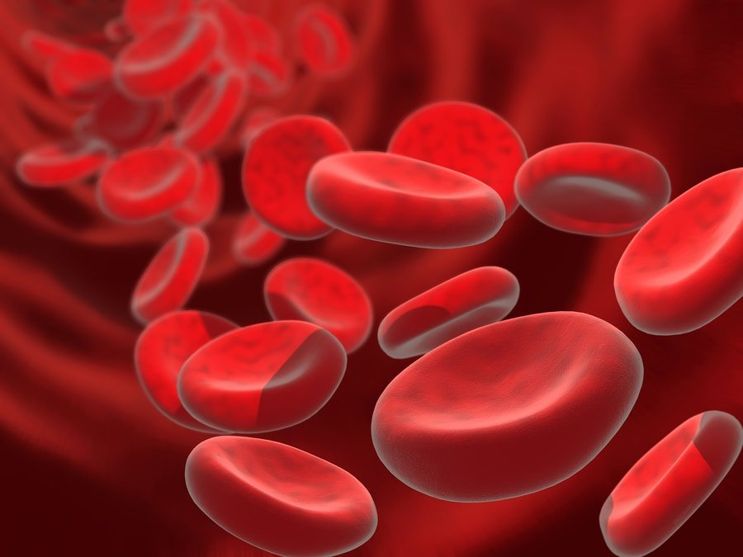
Energy, passion, love, strength, power, heat, aggression, danger, blood, war, confidence, courage

Slide 6
Peace, tranquility, cold, calm, stability, harmony, unity, trust, truth, security, order, loyalty, depression, sadness, loneliness

