Slide 1
Sophomores Class of 2023

Slide 2
Who is your counselor?
A-Chi Mrs. Hunt
Chk-Gi Mrs. Oaxaca
Gl-K Mrs. Daley
L-Ol Mrs. Mitchell
Om-Sh Ms. Culbertson
Si-Z Mrs. Hayes

Slide 3
HAC - Home Access Center
The best way to stay focused is to keep track of your current progress in coursework.
HAC is available within your SSO Screen!
Use HAC information to keep up with your daily assignments. Remember, you can retake tests on which you earned an 80 or less, for a grade up to 80 in non Pre-AP or AP classes. Never settle for a failing test grade, and don’t fall behind in your class work!

Slide 4
PSAT
October 14th, 2020 for Face to Face Learners
October 17th, 2020 for Virtual Learners
FREE for all sophomore students - no need to register
Benefits include:
Extra practice with test
Identify strengths & weaknesses
Potential National Merit Status Award when the
test is taken in junior year.

Slide 5
Transcripts
It is important to continue to work hard and earn the highest grade possible.
Transcripts are sent to colleges in the Fall of senior year. Grades earned through the end of junior year are posted and that is what the colleges use to determine admission.

Slide 6
Unweighted GPA
Unweighted grades are all on a 4.0 scale, no matter if the grade is from an AP, PAP or academic level class
90 – 100 = 4 points
80 – 89 = 3 points
70 – 79 = 2 points
0 – 69 = 0 points

Slide 7
Weighted GPA
Different “weight” is given to each grade. AP and PAP courses can earn more points on the weighted scale.
GPA is based on the 6.0 scale.
Grade | Letter | AP/ Level 3 | PAP/ Dual Cr. / Level 2 | Academic / Level 1
100 | A | 6.0 | 5.0 | 4.0
95 | A | 5.5 | 4.5 | 3.5
90 | A | 5.0 | 4.0 | 3.0
85 | B | 4.5 | 3.5 | 2.5
80 | B | 4.0 | 3.0 | 2.0
75 | C | 3.5 | 2.5 | 1.5
72 | C | 3.2 | 2.2 | 1.2

Slide 8
How do you promote to the next grade level?
In order to promote to the next grade level, students must earn a minimum number of credits by the start of each school year.
0 – 5.5 credits = 9th grade
6.0 – 11.5 credits = 10th grade
12.0 – 17.5 credits = 11th grade
18 or more credits = 12th grade
26 or more credits needed to graduate

Slide 9
STAAR EXAMS
In addition to earning 26 or more credits and fulfilling the courses needed to graduate, students also need to pass the following STAAR exams: (Covid exemptions)
English 1
English 2
Algebra 1
Biology
US History

Slide 10
START PLANNING FOR AFTER HIGH SCHOOL
Start researching colleges and universities on Naviance
Look at the admissions requirements for colleges and universities:
GPA needed
Rank / percentage in your class
SAT/ACT scores needed
College Majors offered
Cost, location, size of school, dorm options, meal plans
Scholarship opportunities
Juniors and seniors may take two days away from school for college visits
Research vocational /technical schools or talk with military recruiters if interested.
Keep building your resume – extracurricular activities, leadership roles, community service, awards received, camps or other unique experiences, work experience, etc.
Use the a resume builder in Naviance.

Slide 11
WEBSITES to KNOW
Naviance
www.naviance.com
SAT & AP Information
www.collegeboard.com
ACT Information
www.actstudent.org
Scholarships
www.fastweb.com

Slide 12
Naviance
Is now available within your SSO welcome screen!
Use Naviance to search for college information, careers you are interested in, scholarships, interest inventory, important documents for school (AP/PAP exit forms, registration information, transcript request forms, and much more).

Slide 13
To Do’s: Boyd Sophomore Survey Strengths Explorer Assessment or Career Interest Profiler Explore SuperMatch College Search Build Resume

Slide 14
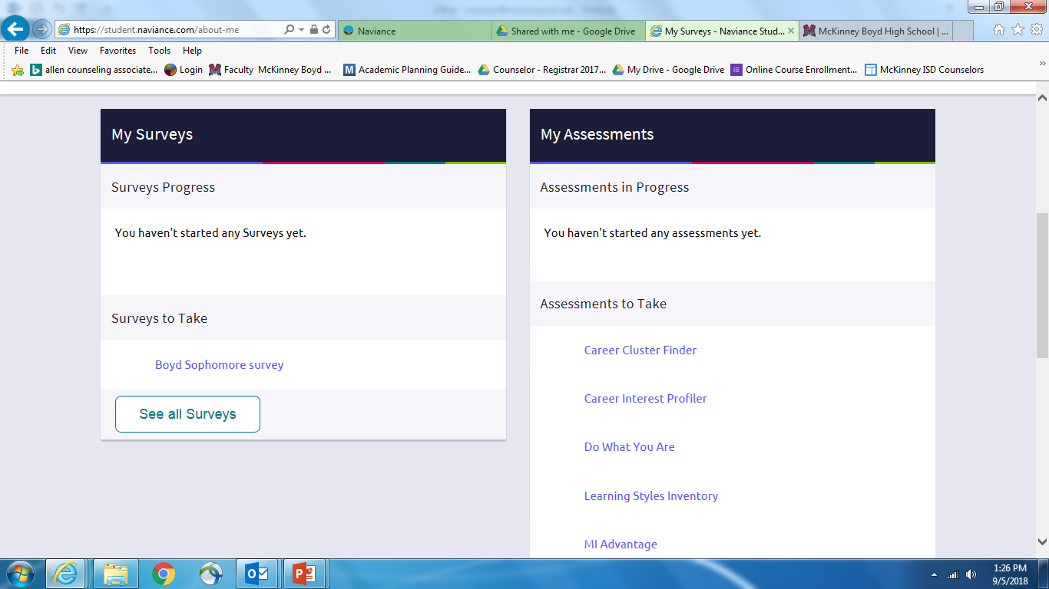
Task to do!
Go to About Me:
Take Boyd Sophomore Survey
Take Strengths Explorer Or Career Interest Profiler

