Slide 2
Objectives
To compare the different civilian jobs in law enforcement.
To explain how civilians can contribute to law enforcement.
To recognize skills needed for civilian jobs in law enforcement.

Slide 3
Main Menu
Introduction
Careers in Emergency Communication
Careers in Community Outreach
Careers in Research & Investigation

Slide 5
Civilian Jobs
Allow individuals to give back to their community while working for law enforcement
civilians provide unique skills which work together with law enforcement officers
Are critical to law enforcement
the success and efficiency of law enforcement can all be affected by the total involvement of civilians within agencies

Slide 6
Civilian Jobs
Improve the efficiency within an agency
civilian employees perform a variety of jobs, allowing police officers to focus on aspects which require their expertise
Are non-sworn positions
civilians serve as the behind the scenes supporters to uniformed, authoritative law enforcement
Fun Fact: Budget cuts have allowed agencies to bring in citizens to provide effective and efficient organizational operations while adapting to budget loss.

Slide 7
Sworn Positions
Are employees within law enforcement who:
have taken an oath to support all laws
have completed extensive training
have full arrest powers granted by the government
can legally carry firearms
Include police officers, highway patrol officers and sheriff’s deputies

Slide 8
Non-Sworn Positions
Are the civilians who assist in various roles within an agency
Do not hold the authority to arrest an individual
Have specific requirements depending on the state in which they are serving
Include administrative and support personnel, investigators and specialists

Slide 9
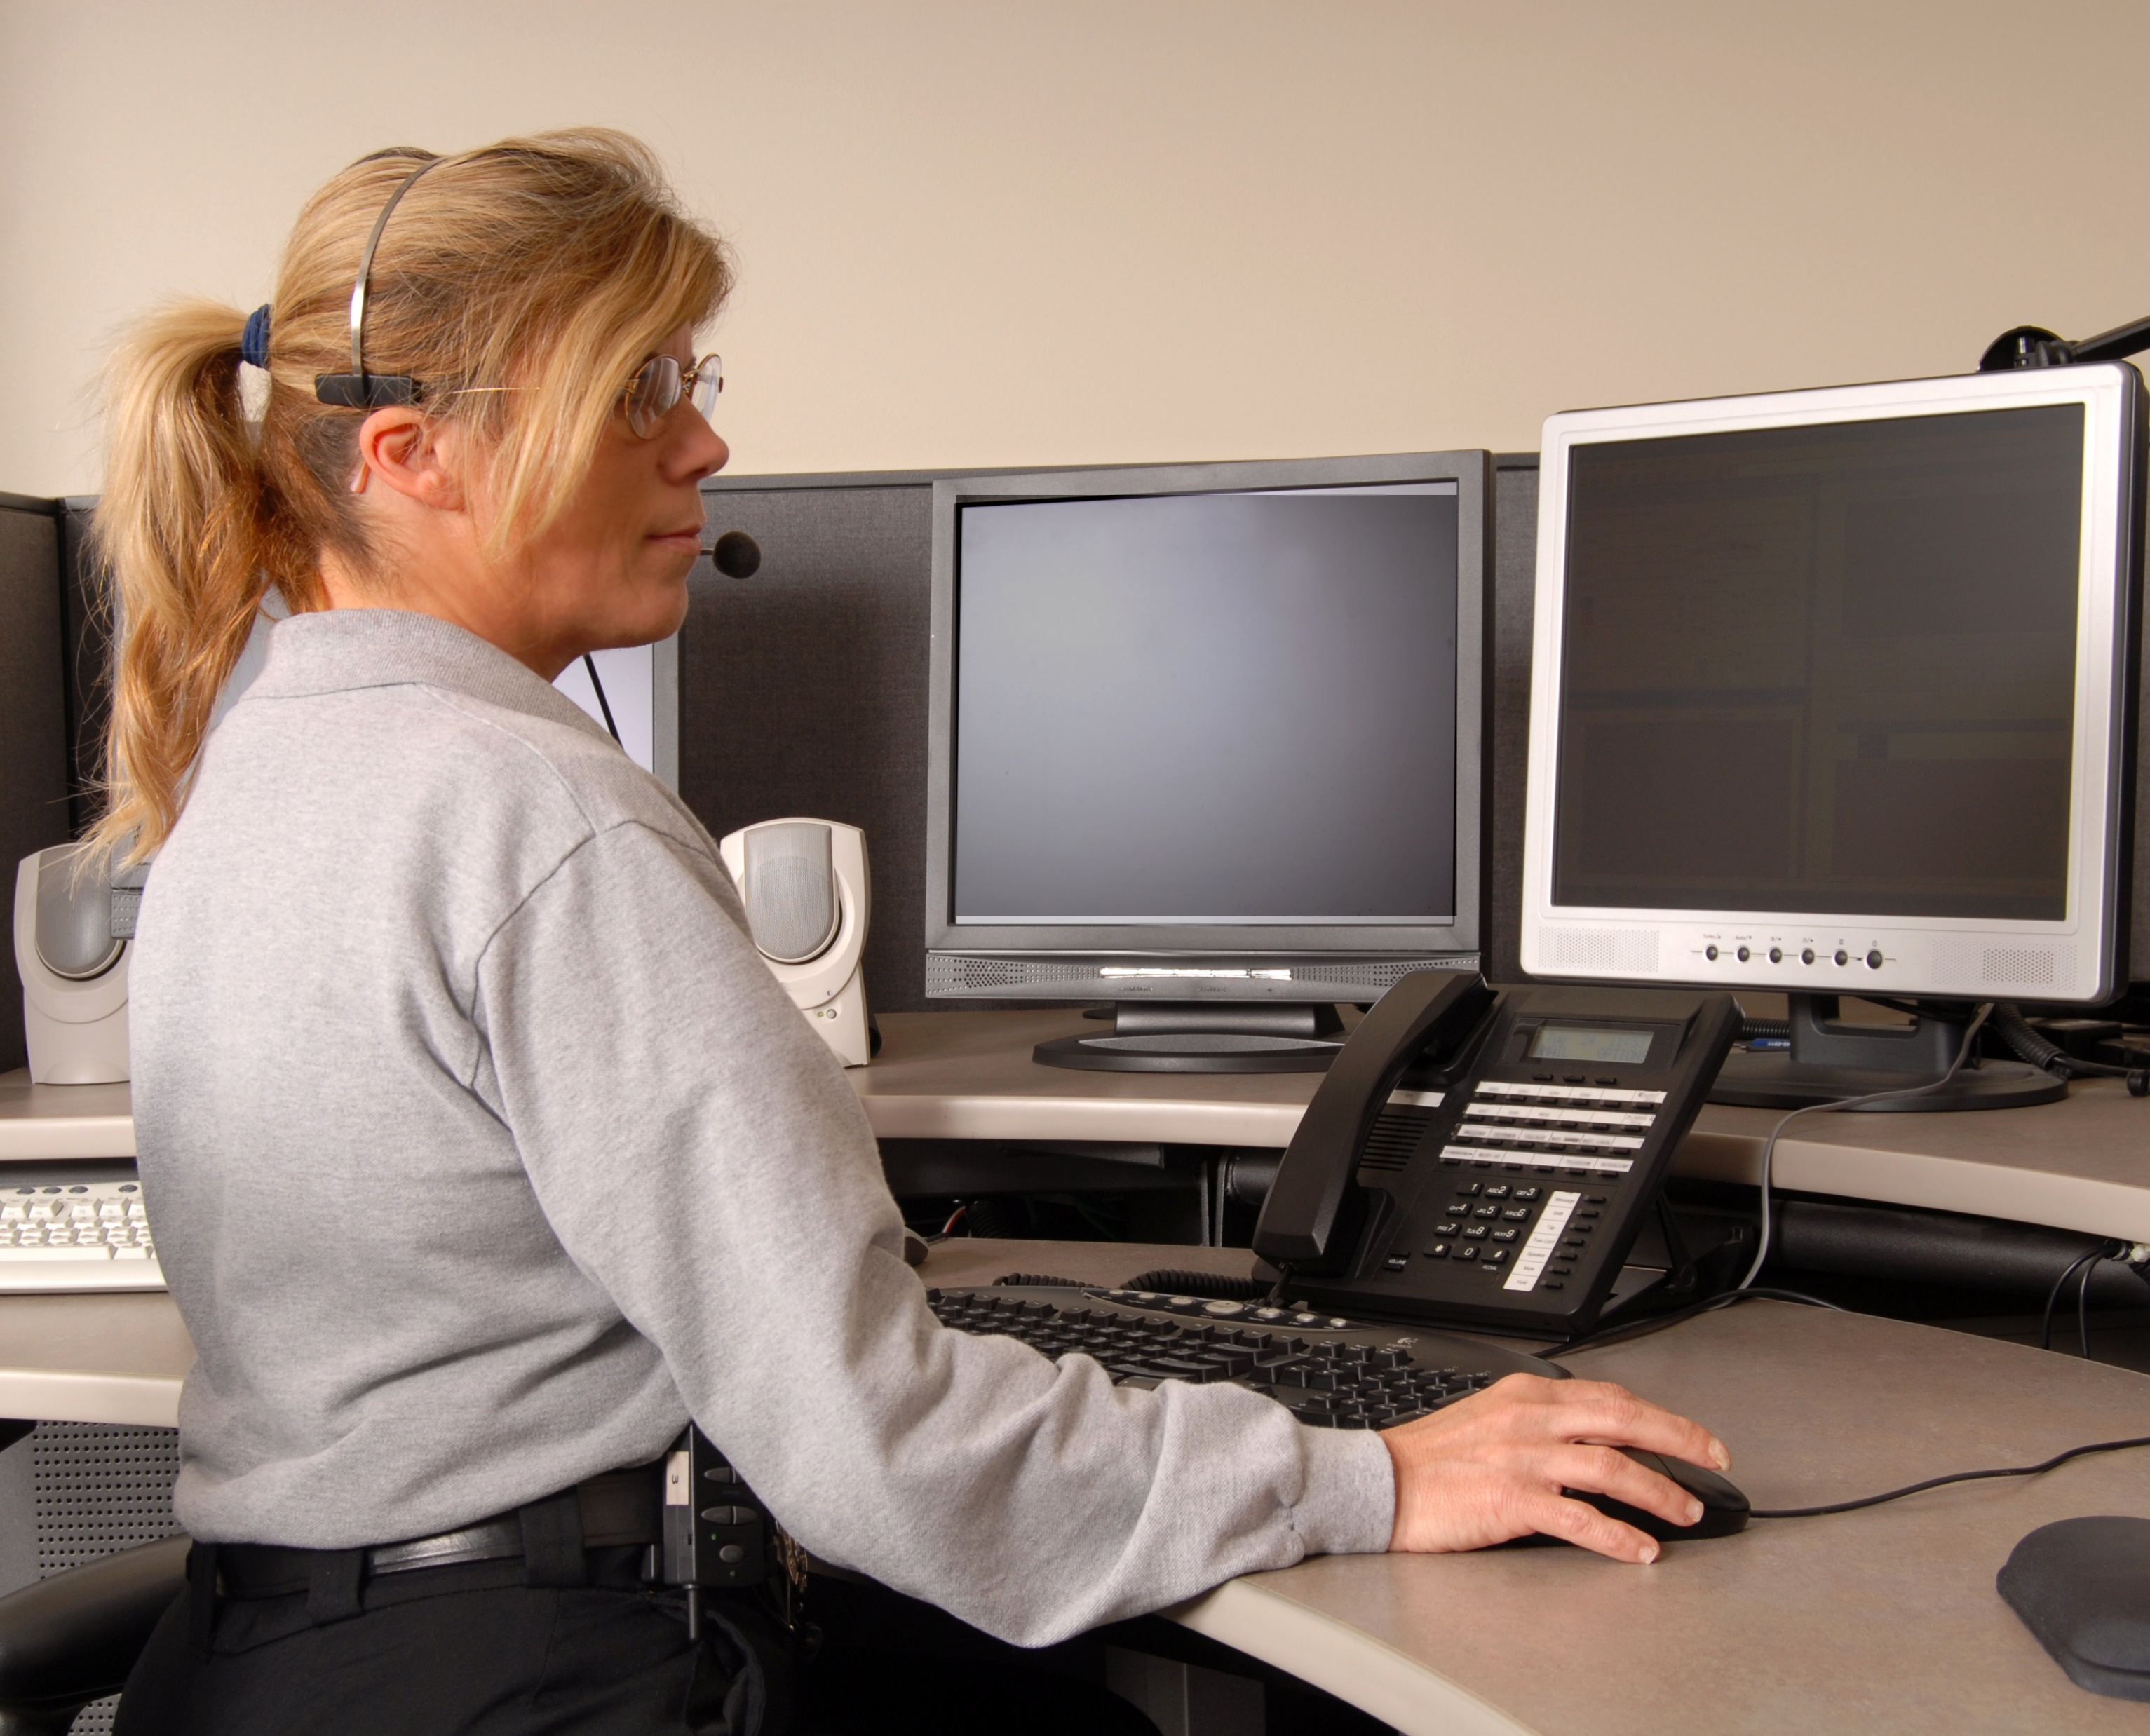
Civilian Jobs
Include various activities such as:
working closely with neighborhood residents
supervising volunteer programs
providing bike and foot patrol
overseeing community resource centers
learning officer safety techniques
responding to crime scenes in a supportive role to the first-responders

Slide 10
Minimum Requirements for Civilian Law Enforcement Careers
Include:
being 21 years old
being a legal U.S. Citizen
obtaining a U.S. high school diploma or GED
having a valid driver’s license and clean driving record

Slide 11
Minimum Requirements for Civilian Law Enforcement Careers
Include:
residing within the jurisdiction, legally
passing the written and multiple choice tests to evaluate English usage and comprehension as well as communication skills
being able to use directional information like north, south, east, west, left or right for quick response to calls
being capable of working in different locations, under all conditions and with anyone

Slide 12
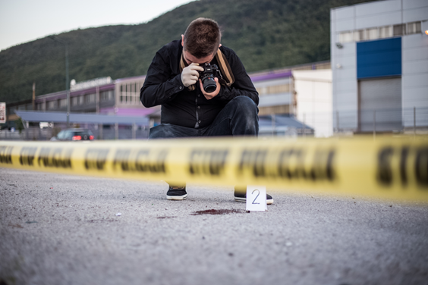
Career Advancement
Is the continuing act of promotions within a career path
Allows room for new ideas and skill sets to influence the overall improvement of an organization
Is an incentive to achieve more than what is expected
Career Clue: If there are no advancements in a career, there is no success.

Slide 13
The Success of an Agency
Is an ongoing process
law enforcement agencies across the nation are constantly seeking ways to improve efficiency and to ensure their duties are properly conducted
Is influenced by:
the citizens in the community
improved relations between agency and community
opportunities for expansion in careers

Slide 15
Emergency Communication
Is the relay of information between law enforcement and the public
Is essential for responding to 9-1-1 service calls in a timely manner
contacting responders with precise details of information
Focuses heavily on efficiency and accuracy

Slide 16
Procedures for Emergency Communication
Outline the proper way to communicate over law enforcement radios
Includes:
selecting the correct channel
clearly pronouncing words
reporting accurate and precise details of information
communicating officer call number before transmitting any information
Career Clue: A call number is a specific number assigned to each officer.

Slide 17
Procedures for Emergency Communication
Includes:
speaking with little emotion
using the minimum amount of words through abbreviations, codes and the phonetic alphabet
describing people by giving visual information and labels
overcoming barriers
Career Clue: Barriers are obstacles during communication, such as radio static and limited time.

Slide 18
Careers in Emergency Communication
Includes:
communications electronic technicians
telecommunications system programmers
police communication operators
media relations coordinators

Slide 19
Communications Electronic Technicians
Install, maintain and repair all technology for law enforcement agencies
Keep all technology equipment running smoothly and efficiently
Are important to keep the communication channels clear and consistent for every incoming and outgoing call

Slide 20
Telecommunications System Programmers
Keep systems and data up-to-date and error free
Serve as the information technician for all communication in law enforcement
Ensure all agencies are running on the most advanced technology
Career Clue: Telecommunications systems are the devices used for distance communication through electrical signal.

Slide 21
Telecommunications System Programmers
Confirm all telecommunication systems are performing to their best ability
examples of telecommunication systems are:
telephones
radios
computer networks

Slide 22
Police Communication Operators
Are also known as dispatchers
Monitor in-car data controllers
Report and filter information related to calls in need of response
Give officers, troopers and agents specific information about what they are approaching
Are essential as they use effective communication techniques to translate information to the responders
Career Clue: Police communication operators work 12-hour shifts, evenings, weekends and holidays.

Slide 23
Media Relations Coordinators
Are the public face for departments and their message
Receive information requests from public and media personnel
Notify the public of any releasable information pertaining to an investigation
Include:
videographers
social media managers
media representatives

Slide 24
Emergency Communication Skills
Needed to be successful include:
being able to work in high stress situations
knowing how to use a radio and telecommunication tools
having outstanding verbal and written communication skills; both giving and interpreting
having an understanding of operational terminology and procedures
having an applicable knowledge of office etiquette and procedures

Slide 25
Emergency Communication Skills
Needed to be successful include:
having excellent interpersonal skills
having knowledge of safety dispatching methods and diversified communication equipment
possessing knowledge of surrounding geography
exhibiting an understanding of policies, terminology and procedures for all branches of responders
can be taught in training if needed

Slide 27
Community Outreach
Allows agencies to
obtain feedback from the community
increase the communities support
Goals include:
understanding expectations from both sides─ the community and the officers
increasing officer safety
building trust and familiarity within the community
motivating citizens to report crimes

Slide 28
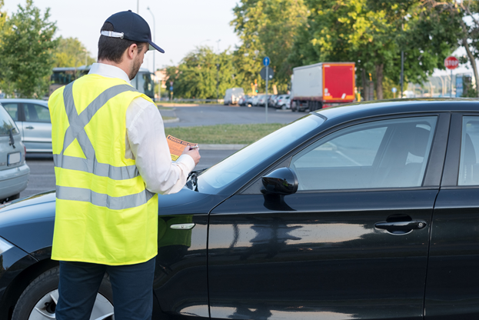
Careers in Community Outreach
Include:
correctional staff/jailers
outside law firms
crime prevention
parking enforcement
parapolice
victim service providers
volunteers
records management
security guards
outside counselors

Slide 29
Correctional Staff/Jailers
Serve as security personnel and handle inmate:
in-take
processing
monitoring
feeding
transportation
Perform the duties of safety facilitators amongst inmates, security both on and off site and correctional officers
Includes all jail staff and personnel

Slide 30
Outside Law Firms
Include individuals who represent their clients in law meetings which are not provided by the government
examples are lawyers and attorneys
Are chosen by the citizen to speak on their behalf including beliefs, opinions and facts pertaining to their side of the case

Slide 31
Crime Prevention
Includes citizens who work alongside law enforcement to educate their community and prevent crime
Duties may include:
volunteering with the neighborhood watch system
participating in the National Crime Prevention Council
attending educational programs
participating in community policing

Slide 32
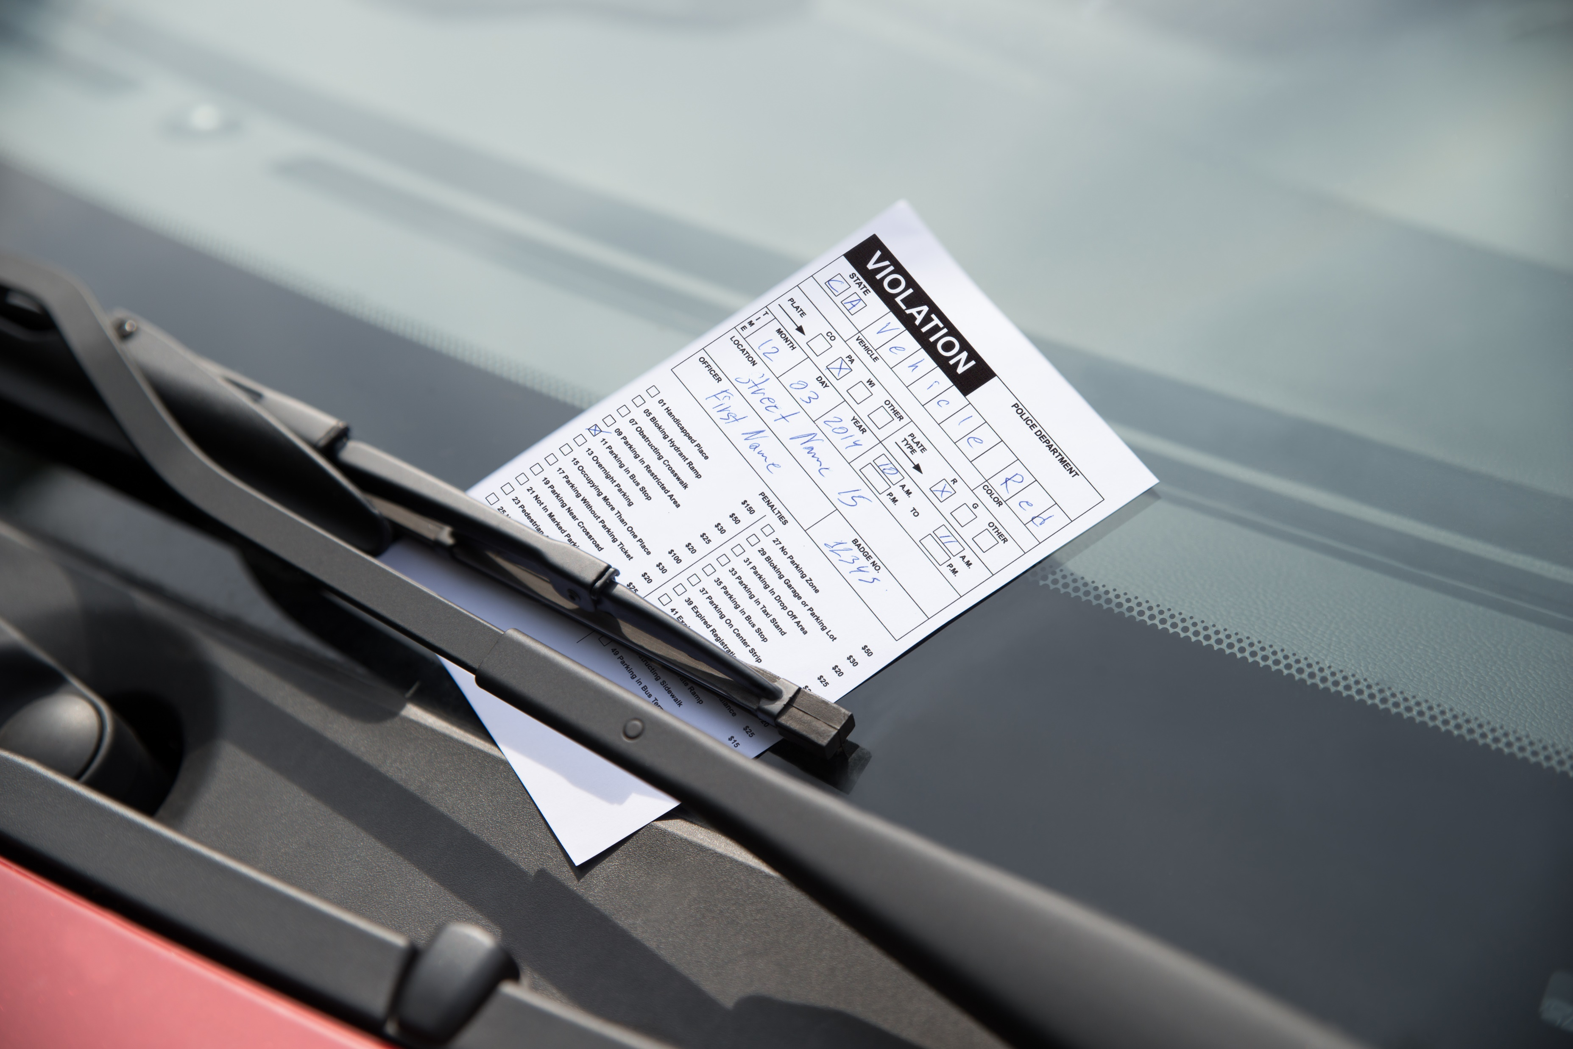
Parking Enforcement
Implements parking laws and handles abandoned or illegally parked vehicles
Duties include writing citations for the following:
unattended vehicles
illegally parked vehicles
vehicles with unpaid parking meters
Assists with traffic control as needed

Slide 33
Parapolice
Serve as public figures to the community in places which are less likely to have criminal activity, such as:
AA meetings
church buildings
Help build relationships between the community and law enforcement
Are community outreach and police enforcement combined
are not armed and cannot use force

Slide 34
Victim Service Providers
Support and assist victims, families and witnesses
Are mostly nonprofit organizations, such as:
safe homes
private support and recovery services
crisis hotlines
Serve as advocates for victims in court

Slide 35
Volunteers
Are members within the community they are serving
Are non-paid individuals
Handle the department’s office and paperwork when possible
Allow officers to focus on primary duties outside of the office

Slide 36
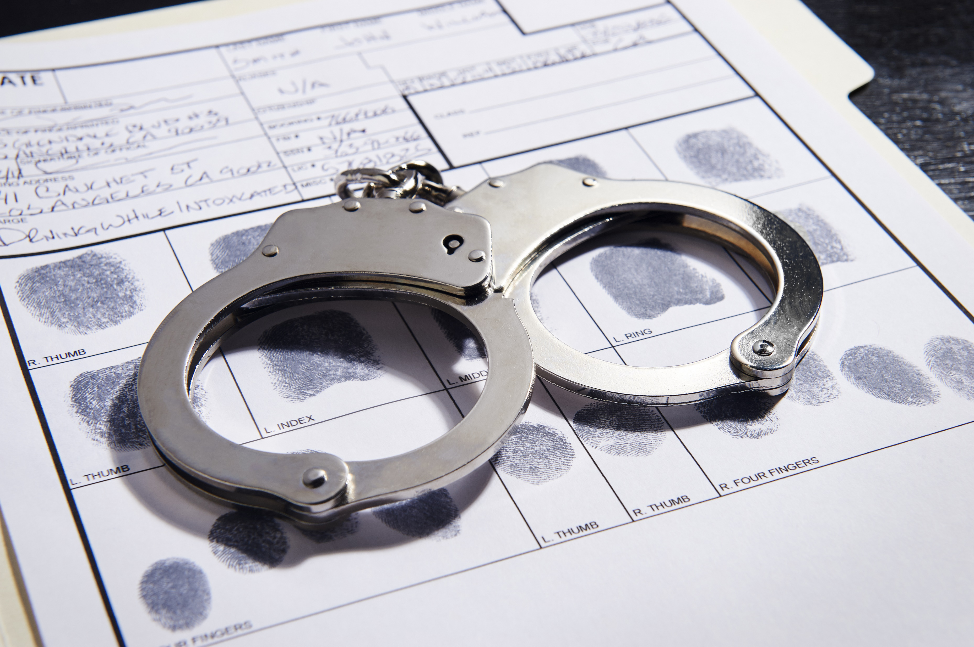
Records Management
Oversees records and data from all actions of an officer
arrests and bookings
reports
warrants
evidence form a scene
case information
registrations
summons
vehicle tows
interviews
Practices organizational behaviors daily

Slide 37
Security Guards
Protect other civilians from minor criminal activities, suspicious behaviors and any threats to public safety
Serve in highly populated public locations
such as malls, museums and airports
Can operate security checkpoints
such as metal detectors at the entrance of a building

Slide 38
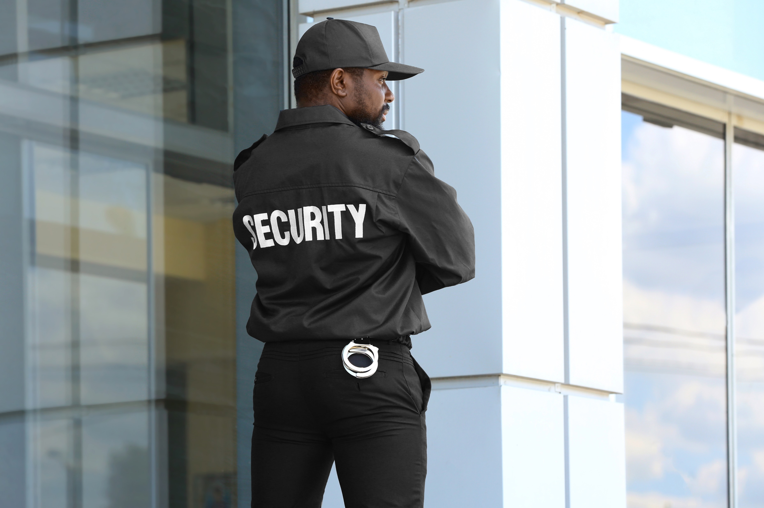
Security Guards
Write a daily report over any observations while on duty
Act undercover occasionally to assist sworn officers

Slide 39
Outside Counselors
Serve outside of active criminal cases
mostly for post care
Serve the following:
individuals
couples
families
adults
children
adolescents
victims
law enforcement employees

Slide 40
Community Outreach Skills
Needed to be successful include:
excellent verbal and written communication
positive and friendly attitude
good computer skills
an eye for details
well known community presence
a grasp understanding for the law

Slide 42
Research & Investigation
Includes civilians working to improve the community or training individuals with a specialization
Involves civilians who collect evidence and analyze data
Goals include collecting:
consistent evidence
precise details
accurate information
Career Clue: Research is the process of studying to discover something never known before. Investigation is to find out something which already has a known answer.

Slide 43
Research & Investigation
Serves as the “behind the scenes” personnel for police officers
Allows individuals to learn the details behind law enforcement
Are constantly looking for new ways to improve the agency

Slide 44
Careers in Research & Investigation
Include:
civilian investigators
information technology specialists
crime analysts
forensic technicians
intelligence analysts
equipment/fleet management
property/evidence management
instructors/professors of law enforcement
planners/researchers

Slide 45
Civilian Investigators
Are individuals who examine and discover the facts in incidents, such as:
traffic collisions
financial crimes
property crimes
crimes against persons
Study crimes which violate civil rights
Duties include:
collecting data from the scene
interviewing witnesses and victims
reporting any alarming evidence to police

Slide 46
Information Technology Specialists
Keep systems up-to-date and running correctly
Service all technical issues to keep the agency efficient
Ensure all technology is running on the most advanced systems
Are also known as IT specialists

Slide 47
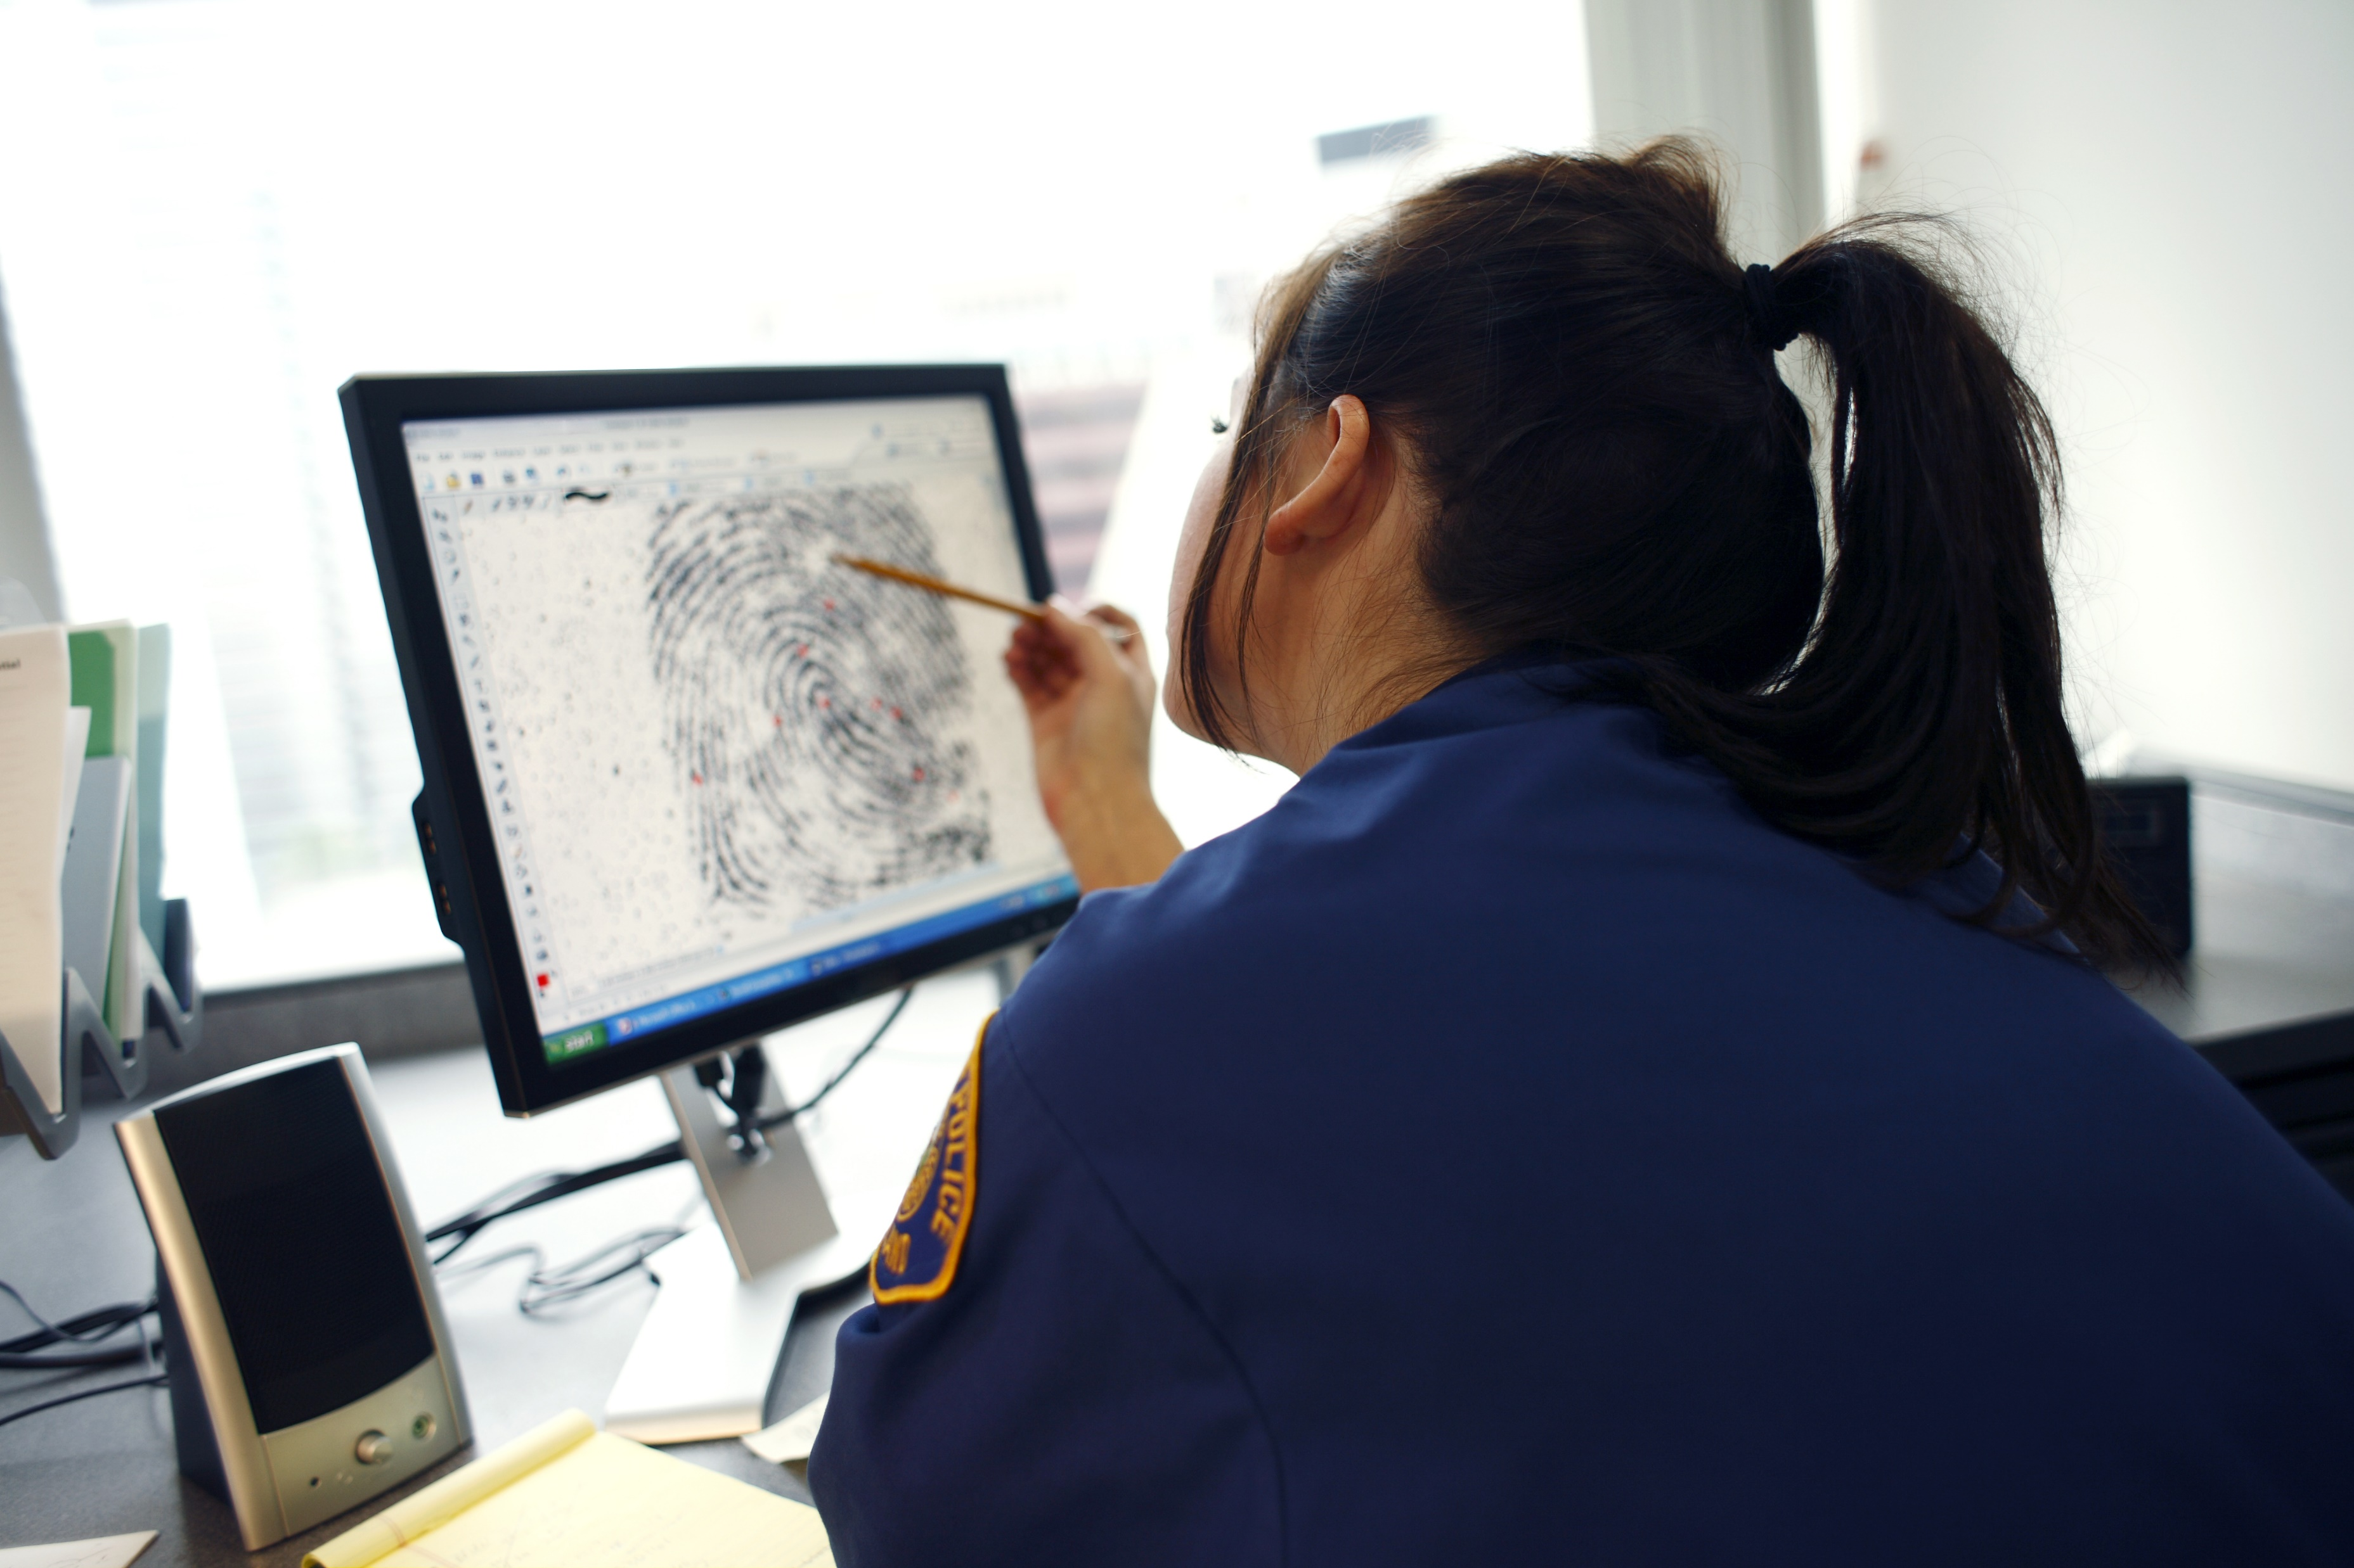
Crime Analysts
Are trained individuals who analyze data collected from a scene
Translate all evidence into a report for an investigation
Examine information for missing data or indication of a crime
Study trends within an area or similar patterns of crime activity

Slide 48
Forensic Technicians
Are trained professionals who collect precise details and facts from crime scenes
Are on call 24 hours a day to photograph, swab for DNA and run any labs from the crime scene
Record accurate information for each piece of evidence collected
including location, condition or abnormalities
Can testify as expert witnesses in a court appearance to report all scientific evidence

Slide 49
Intelligence Analysts
Are specially trained to collate and interpret information from numerous sources gathered in the field
Assess threats in order to prevent attacks
Work along with the government and community for the safety of the country

Slide 50
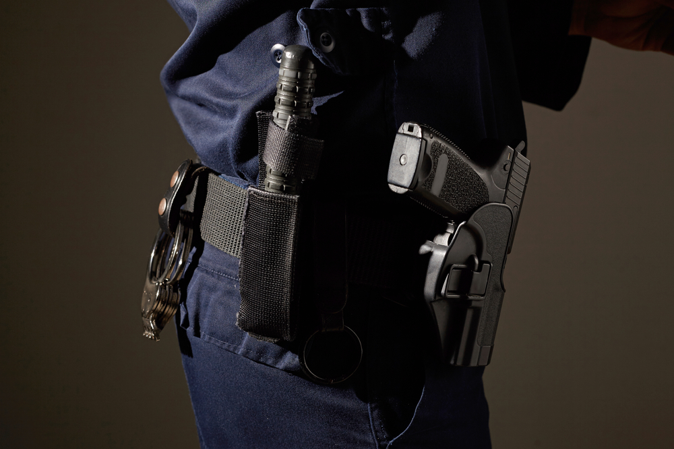
Equipment/Fleet Management
Includes individuals who maintain the upkeep of all uniforms and other equipment needed by the department
Services all vehicles and equipment used on duty
Inspects all types of equipment and verifies all safety regulations are met

Slide 51
Property/Evidence Management
Manages and organizes inventory of evidence and items which have been seized from a crime scene
Must understand how to properly handle each type of evidence collected and how to properly store the materials
evidence may be physical objects, DNA samples, digital, reports, statements or anything else which can be collected and analyzed

Slide 52
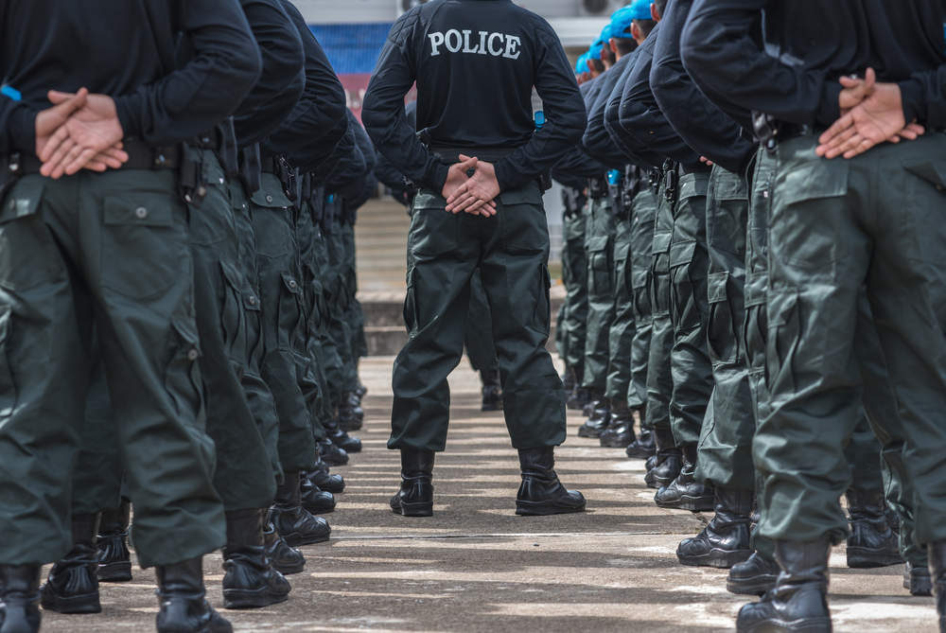
Instructors/Professors of Law Enforcement
Educate individuals who have a desire for a career in law enforcement
Are individuals who have previously served in a sworn position
Train and prepare all perspective applicants for the academy and tests to become a part of sworn positions in law enforcement

Slide 53
Planners/Researchers
Are professionals who perform grant management, strategic planning and coordinate agency policies and accredited issues
Communicate to the employees, other agencies and community about reportable policies and analyzed findings

Slide 54
Research & Investigation Skills
Needed to be successful include:
being detail oriented
having exceptional verbal and written communication skills
being able to problem solve
having a curious demeanor
understanding legal procedures
being able to work well in a group atmosphere
having excellent computer skills
having completed a bachelor’s degree for most careers

Slide 55
Resources
http://agency.governmentjobs.com/txdps/default.cfm?action=agencyspecs&amp;agencyID=2065
http://work.chron.com/police-communications-officer-job-description-22970.html
https://books.google.com/books?id=725qCgAAQBAJ&pg=PT50&dq=qualifications+for+a+public+safety+operator&hl=en&sa=X&ved=0ahUKEwjX2I-YzdrZAhUDVK0KHdNQCA8Q6AEIJzAA#v=onepage&q=qualifications&f=false
https://www.isomitigation.com/emergency-communications
https://login.icevonline.com/public/assets/29496/CEV70833_Teacher_Notes.pdf
http://www.discoverpolicing.org/whats_like/?fa=civilian_alternatives
http://apps.mesaaz.gov/jobdescriptions/documents/JobDescriptions/cs4847.pdf

Slide 56
Resources
https://www.envisagenow.com/civilianization-may-improve-police-effectiveness-in-face-of-budget-crisis/
https://www.sokanu.com/careers/intelligence-analyst/
http://www.lexipol.com/news/value-civilians-in-law-enforcement-building-better-team/
https://www.saintleo.edu/blog/online-criminal-justice-degree-15-civilian-careers-in-law-enforcement
https://www.officer.com/home/article/10233857/civilian-roles-in-policing
http://www.hero911.org/police-community-outreach-efforts-yield-positive-results/
https://www.lawenforcementcareerstips.com/important-education-skills-law-enforcement-officers/
https://www.correctionalofficeredu.org/what-is-a-correctional-officer/
https://www.crimesolutions.gov/TopicDetails.aspx?ID=10
http://www.itiusa.com/rms

Slide 57
Acknowledgements
Production Coordinator
Kaitlyn Gibson
Brand Manager
Stevi Huffaker
Graphics Editor
Melody Rowell
Quality Control Director
Angela Dehls
V.P. of Brand Management
Clayton Franklin
Executive Producer
Gordon W. Davis, Ph.D.
© MMXVIII
CEV Multimedia, Ltd.

