Slide 1
Written Reports In Law Enforcement

Slide 2
Objectives
To describe the components of a police call sheet, an incident report and a supplemental report, as well as why each is important.
To write clear, coherent law enforcement reports.
To demonstrate obtaining the appropriate information in a police call sheet, an incident report and a supplemental report.

Slide 3
Main Menu
Report Writing Tips
Types of Reports

Slide 4
Report Writing Tips

Slide 5
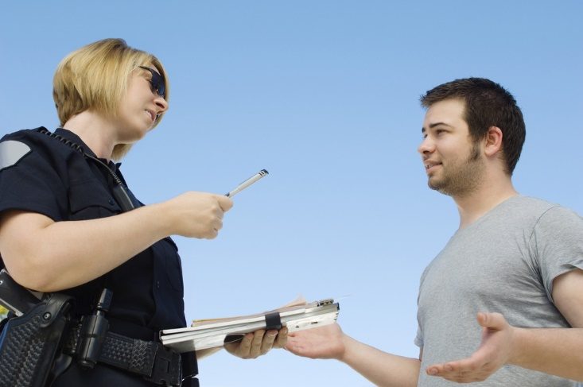
Technical Writing
Is written communication intended to inform an audience of practical or scientific knowledge
Is used in law enforcement to create
police call sheets
incident reports
supplemental reports

Slide 6
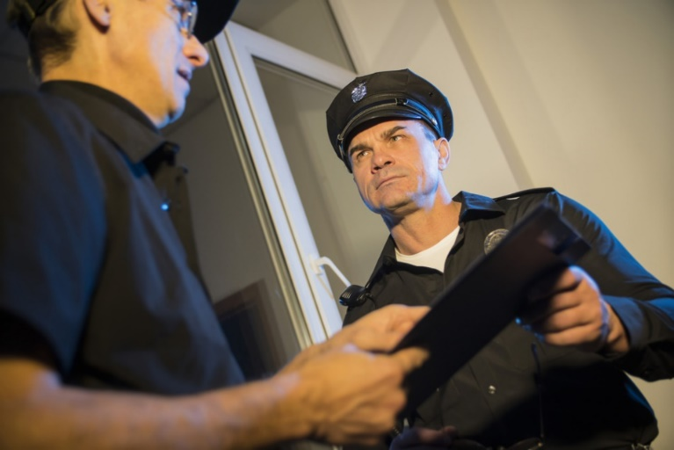
Communication Skills
Are necessary for law enforcement
call sheets and reports are used to help police investigators and prosecutors develop theories about cases
may also be used directly as evidence in a court case
officers are required to testify in court and must be able to explain complicated concepts to jurors

Slide 7
Communication Skills
Are necessary for law enforcement
officers who are in constant contact with the public and other law enforcement professionals
when communicating with the public, law enforcement officials must speak with confidence and a level head to diffuse a situation
when communicating with other law enforcement professionals, officers must communicate as accurately and effectively as possible to accomplish goals and duties

Slide 8
Technical Writing
Should allow the audience to easily find and understand specific information
Must be:
accurate
clear
concise
organized
data-based

Slide 9
Accuracy
Requires writing specific and true information while composing the content
avoid generalizations, such as:
more and many
large and small
provide all relevant information with the most detail
follow protocol (use the correct forms)
edit report (check for spelling)
For example: Instead of “The man was going very fast,” use “The man was going 15 miles per hour in excess of the 65 miles per hour limit on Highway 251 southbound toward Rochelle, IL.”

Slide 10
Clarity
Requires writing content which is easily understandable
Involves:
using terms familiar to the audience
defining unfamiliar words when necessary
explaining difficult concepts in simplified language
avoiding complex words to look impressive

Slide 11
Clarity
Involves:
using concrete language
do not use figurative or metaphorical language which requires interpretation
using an outline to ensure logical organization of information

Slide 12
Conciseness
Aids with clarity and allows the audience to easily identify essential information
Involves:
removing extra or unnecessary words
for example, use “result” instead of “end result”
including necessary information

Slide 13
Organization
Allows the audience to find appropriate information quickly
provides scannability
Requires:
presenting information in a logical order
using headings and graphic elements to indicate where information is located
structuring the narrative by writing the report in active voice (first person)
Scannability - ability for a text to be read quickly in a glance

Slide 14
Data
Include facts and statistics
objective details based on results from research and investigation
Are used to develop and support conclusions

Slide 15
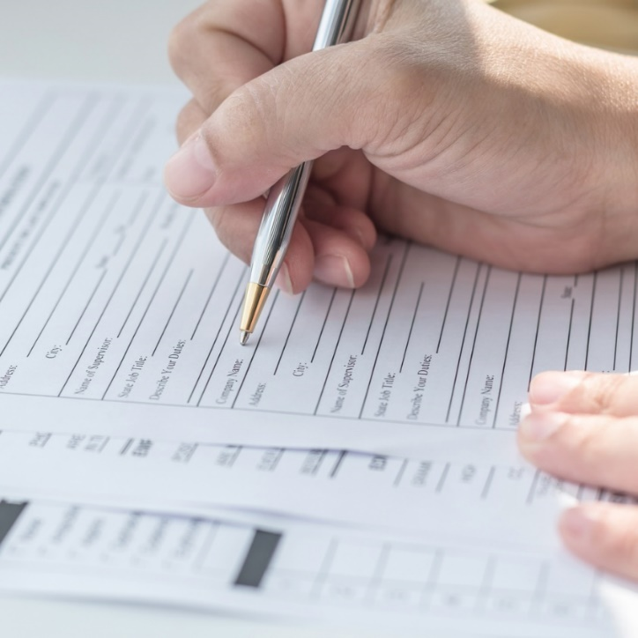
Common Genres in Law Enforcement
Include:
police call sheet
incident report
supplemental reports
Genre: refers to a group or classification of texts which are similar in style, form or subject matter. Genre is commonly used to classify creative writing (e.g. science fiction, romance, mystery), but genre can be used to classify technical writing as well.

Slide 16
Genre
Dictates how to format technical documents
genre expectations explain how to write, what to write and how to organize and distribute text

Slide 17
Types Of Reports

Slide 18
Law Enforcement Documents
Are considered legal documents
used in court as evidence
cannot be altered once created
Are not always accessible to the public
may be used in ongoing court cases
may allow for retaliation
endangering individuals’ safety
Are often formatted differently by various departments

Slide 19
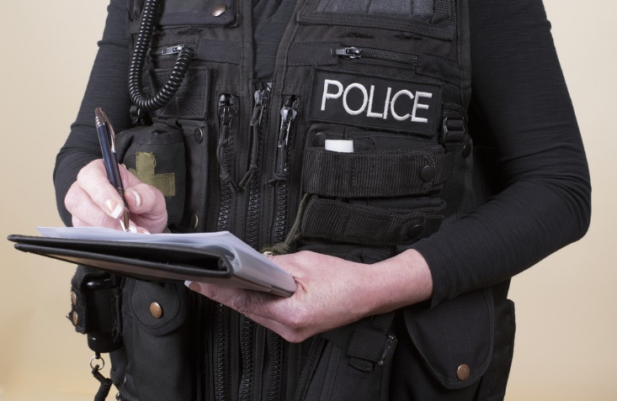
Types of Reports
Include:
police call sheets
incident reports
supplemental reports

Slide 20
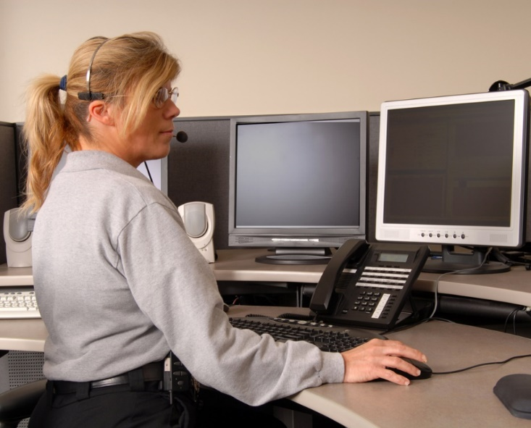
Police Call Sheets
Are also referred to as “call logs”
Are used when documenting incoming 911 calls
can be viewed by the public for informational purposes only
does not document whether a person is guilty or charged with a crime

Slide 21
Police Call Sheets
Are a collaboration between the 911 operator and the police officer
911 operators record the initial information
name, location and a brief summary of the situation
police officers record continued information at the scene
name, address, birthdate, a description of the situation, why the 911 call was made and what was done at the scene to attempt to resolve the situation

Slide 22
911 Operators
Ask specific questions to gather as much information as possible in order to dispatch the correct officials to the incident
Are trained to remain calm in intense situations and provide the caller with as much assistance as possible
many operators are trained to provide real-time instruction in CPR and first aid while dispatching emergency personnel at the same time

Slide 23
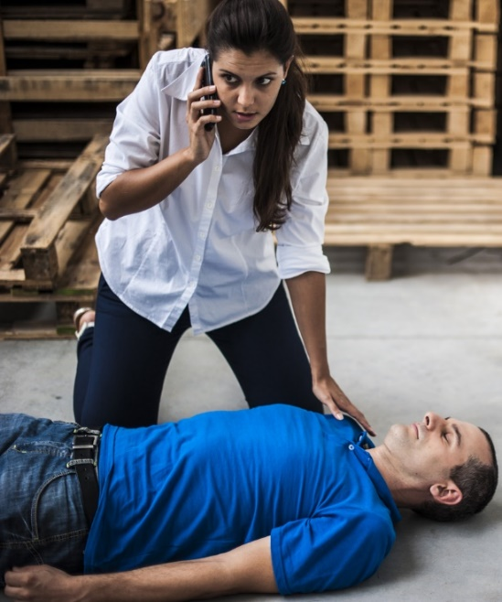
911 Operators
Ask questions pertaining to the following information:
address of the emergency
call back number for verification
caller’s name and if they are involved
person’s problem or the type of incident
approximate age of the victim
if the victim is conscious and/or breathing

Slide 24
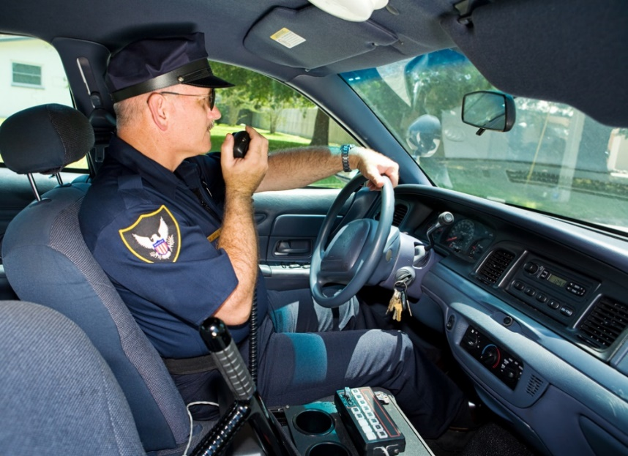
911 Operators
Record the information given by the 911 caller in a computer system
police officers are able to retrieve the information from the 911 operator to assist their investigation when arriving to the scene of the incident

Slide 25
Police Officers
Contribute comments to the system after arriving at the scene of the incident
such as call classification, additional facts of the situation, legal action taken, etc.
May add comments directly to the computer system themselves or may report comments to the dispatcher for documentation

Slide 26
Police Call Sheets
Are important for organizing incoming calls and outgoing dispatches
may be referred back to for legal purposes, if necessary
Only display certain information to the public, such as:
date and time the call was made
address of the incident
nature of the incident
incident number
unit dispatched

Slide 27
Police Call Sheets

Slide 28
Incident Reports
Are used to document factual details of a criminal incident
Are written by police officers who investigate the incident
Describe the who, what, why, when and how of an incident
Can also be known as a criminal investigation report

Slide 29
Incident Reports
Should clearly, accurately and objectively describe the details of the event, such as:
what happened
when it happened
who was involved
Are written by the arresting officer
Arresting Officer: officer who plays the lead role in the arrest of the suspect

Slide 30
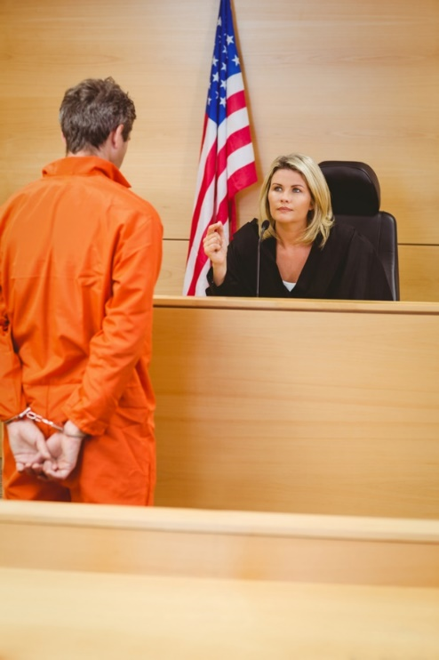
Incident Reports
Can be used in a court of law
can lead to a conviction
Can only be accessed by the public through an application process
the county clerk must approve applications to obtain a copy of incident reports
must be involved in the situation

Slide 31
Incident Reports
Typically include the following sections:
summary
includes the location of the incident, the date of the incident and the reporter of the incident
offense details
includes information pertaining to the criminal act and why the call was made
offender details
includes personal information pertaining to the criminal

Slide 32
Incident Reports

Slide 33
Supplemental Reports
Are additional records used to describe the situation and the scene
Are supplied by officials on the scene who did not make the arrest
for example, specialists who arrived at the crime scene after the responding officer
Are submitted to provide additional information to the investigation

Slide 34
Supplemental Reports
Typically include the following sections:
supplemental details
date of the original report, agency case number, location of the incident, victim or witness information
narrative
basic information linked to the original incident

Slide 35
Supplemental Reports

Slide 36
Common Problems with Reports
May cause miscommunication
Include:
use of ambiguous terms
authors of different reports often put the names and addresses of suspects, witnesses and victims in the heading, describing these individuals in the report as “subject #1” or “victim #2”
spelling
misspelling names on any report can lead to the wrong person being detained or convicted

Slide 37
Common Problems with Reports
Include:
not enough detail
important to include all relevant actions, statements and observations in a report, never leaving out details which could be important at trial
run-on sentences
punctuation helps the reader comprehend the message in a clear and logical way

Slide 38
Resources
HigherEd(2007). Police Reports and Their Purpose. Retrieved from http://highered.mheducation.com/sites/dl/free/0078111463/945394/Ch01.pdf
Redwine, K. (2003). Importance of the Police Report. Criminal Justice Institute. Retrieved from http://www.cji.edu/site/assets/files/1921/importance_of_police_reports.pdf
Hoots, A. (2013). Quality Report Writing in Law Enforcement. Retrieved from http://www.cji.edu/site/.../the-importance-of-quality-reportwriting-in-law_enforcement.pdf

Slide 39
Acknowledgements
Production Coordinators
Jayde Farbo
Sydney Buckley
Brand Manager
Amy Hogan
Graphics Editor
Melody Rowell
Quality Control Director
Angela Dehls
V.P. of Brand Management
Clayton Franklin
Executive Producer
Gordon W. Davis, Ph.D.
© MMXVII
CEV Multimedia, Ltd.

