Slide 1
Tactical Entry

Slide 2
Objectives
To define and identify goals of tactical entry.
To discuss protective equipment used by tactical teams.
To explore methods law enforcement use to breach buildings.
To explain techniques used to safely enter, search and clear buildings.

Slide 3
Main Menu
Introduction
Tactical Teams Video Segment
Methods of Entry
Searching & Clearing
Procedures Video Segment

Slide 4
Introduction

Slide 5
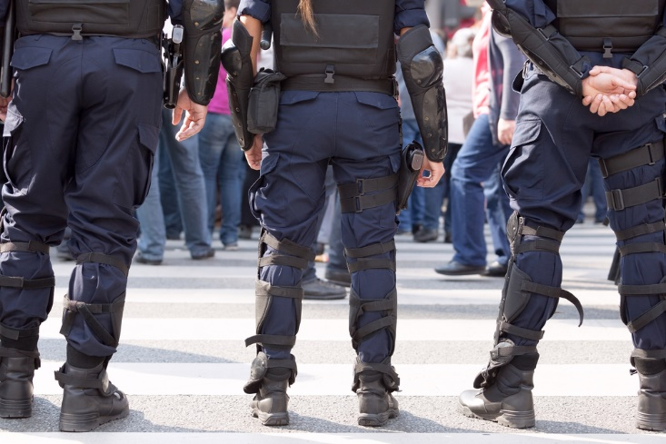
Law Enforcement
Is often required to enter private buildings to perform duties, such as:
executing an arrest
performing a search
seizing evidence, contraband, etc.
protecting victims, witnesses, hostages, etc.
investigating reports of criminal behavior

Slide 6
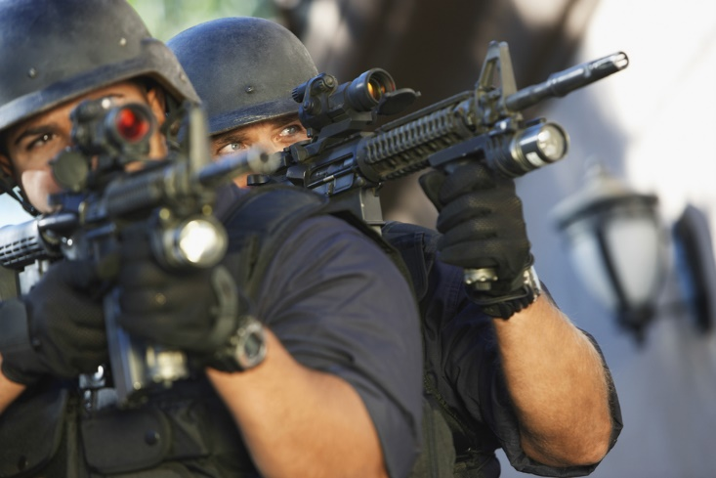
Law Enforcement
Must have legal justification for entering a private building or residence
the 4th Amendment provides for privacy and protects against unreasonable search and seizure

Slide 7
Legal Justification
For entry includes any of the following:
search or arrest warrant
consent of property owner or resident
emergency rescue
threat to officer or public safety
pursuit of a detainee, arrestee or dangerous suspect
prevention of substantial property damage

Slide 8
Tactical Entry
Is a term used to describe the execution of precisely planned building entry for a specific purpose
usually to perform an arrest or search
Is most often used in high-risk situations
when the likelihood of resistance appears great, increasing the danger to officers and the public
Some tactical techniques may be used in lower-risk situations, but generally, the term ‘tactical entry’ refers to high-risk entry.

Slide 9
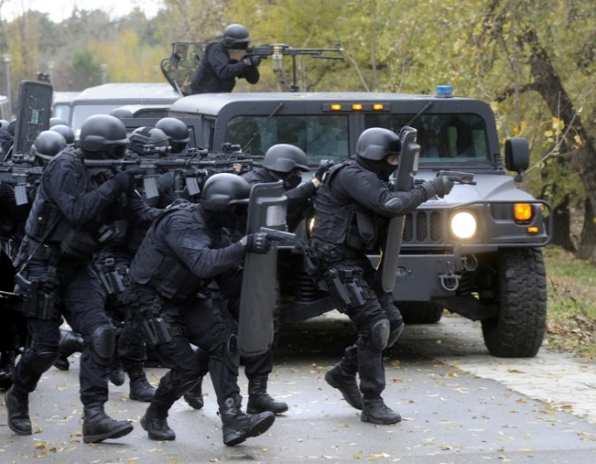
Tactical Entry
Is a major responsibility of SWAT teams
short for Special Weapons and Tactics, these officers specialize in high-risk tasks
May be required of a variety of officers
first responders may encounter the need for tactical entry
many smaller departments do not have distinct SWAT teams

Slide 10
Goals of Tactical Entry
Include:
complete law enforcement mission
performing arrest, search, seizure, etc.
maintain safety of all involved
prioritizing officers and bystanders
avoiding harm to suspects when possible
minimize property damage
using least amount of force necessary

Slide 11
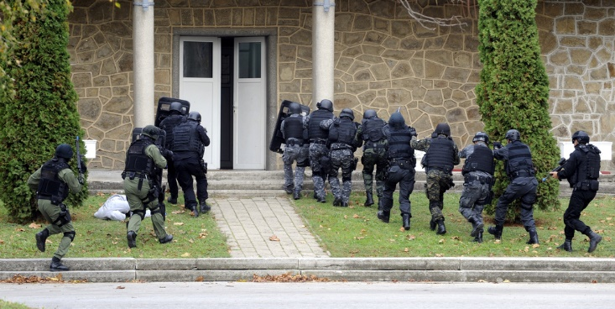
Goals of Tactical Entry
Must be prioritized
one goal may have to be forfeited to meet a more important goal
for example, property damage or harm to suspects may be acceptable if required to complete the mission and keep officers or bystanders safe

Slide 12
Tactical Thinking
Involves making decisions based on consideration of the following:
mission
risks involved
time and resources available
Requires thinking about every possible scenario and making many “if-then” decisions
“if X occurs, then Y is the proper reaction”

Slide 13
Tactical Thinking
Is used before entry to prioritize goals and form plans
when officers can methodically think through every variable
Is used during entry to evaluate the situation and react sensibly
with enough practice, it becomes instinctive

Slide 14
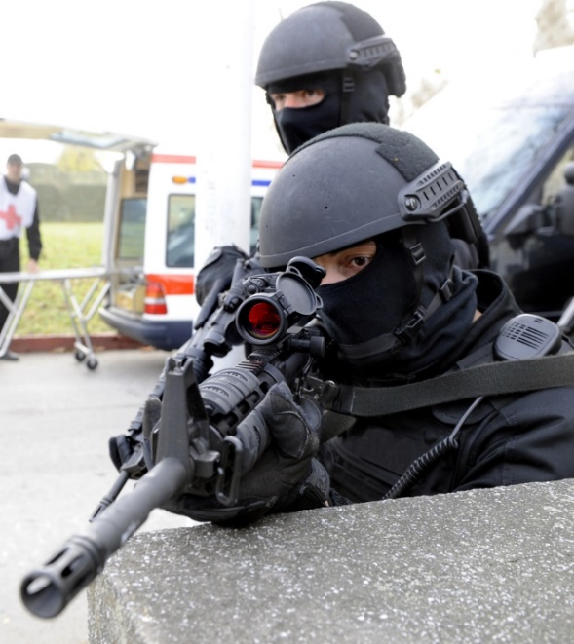
Tactical Entry
Requires extensive training
skills
marksmanship, hand-to-hand combat, arrest techniques, etc.
tactics
movement, use of cover, communication, etc.
mindset
vigilance, composure, decision making, etc.
Requires ongoing education and practice

Slide 15
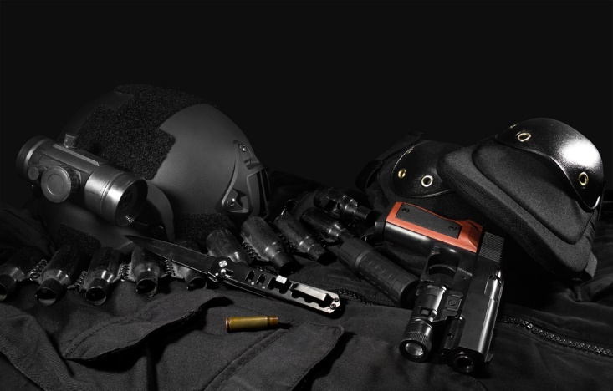
Tactical Entry
Requires extensive personal protective equipment
body armor
masks
gloves
shields

Slide 16
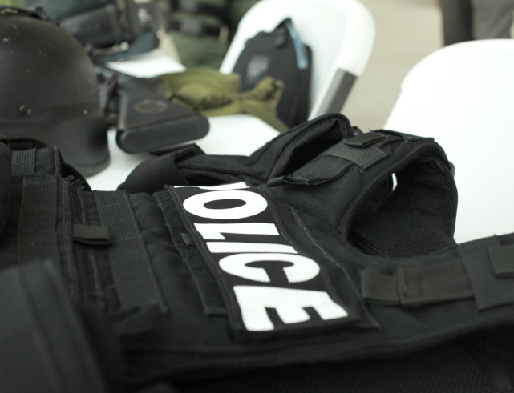
Tactical Body Armor
Includes vests, helmets and full-body protection
Includes varieties designed to provide varying degrees of the following:
ballistic protection
for bullets and shrapnel
edged blade protection
for knives
spike protection
for spiked weapons such as ice picks

Slide 17
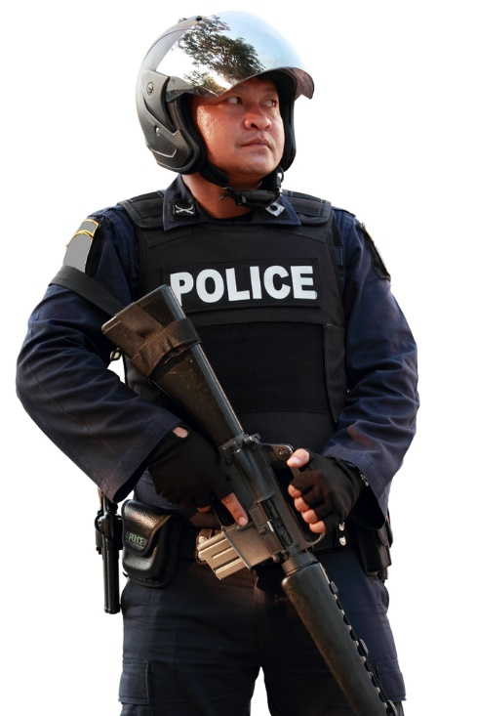
Tactical Body Armor
May be made of the following:
hard ceramic or plastic plates
advanced woven fibers such as Kevlar®
a combination of the two
Must provide protection while being functional
should allow for freedom of movement
may need to be concealed
weight and heat should be considered

Slide 18
Tactical Masks
Include the following:
respirators (gas masks)
designed to protect against inhalation of toxins
balaclavas
designed to protect the wearer’s identity
ballistic masks
designed to protect against bullets

Slide 19
Tactical Gloves
Are designed to protect the wearer’s hands and provide increased grip
Include varieties with varying levels of insulation, padding and flexibility
Are available in many combinations of materials including leather, fabric, Kevlar®, molded plastic, rubber, etc.

Slide 20
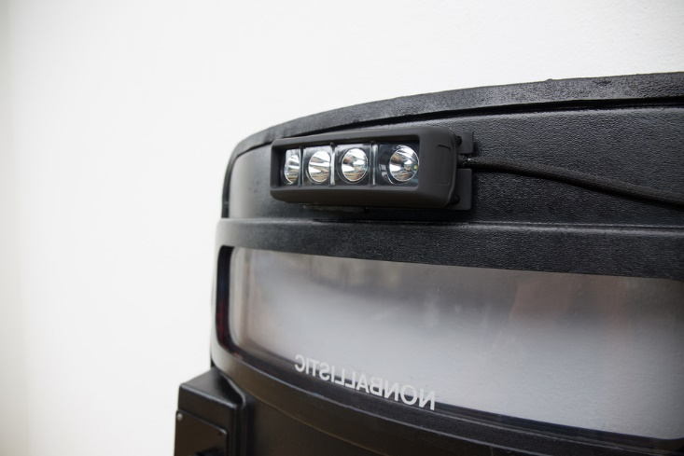
Tactical Shields
Are shields designed to deflect bullets and hand-thrown projectiles such as rocks
Include varieties which incorporate clear viewing visors, carrying straps, kickstands, and/or lighting systems
Are available in a variety of shapes, sizes and materials

Slide 21
Play iCEV Video
Teacher Instructions:
Show the Tactical Teams video segment

Slide 22
Methods of Entry

Slide 23
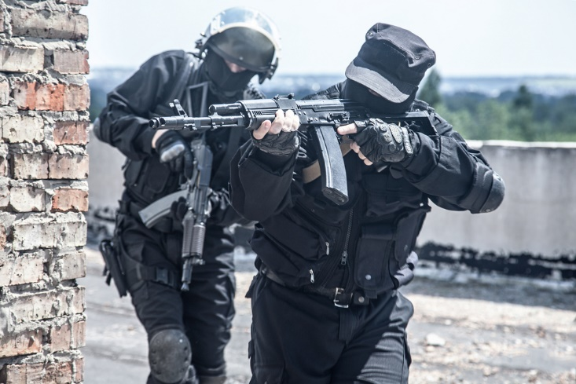
Tactical Entry Approach
Requires officers be:
cautious
quick
quiet
stealthy
organized

Slide 24
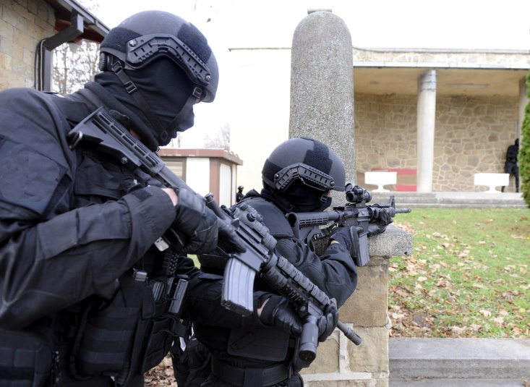
Tactical Entry
Can be performed a variety of ways
dynamic
deliberate
ruse

Slide 25
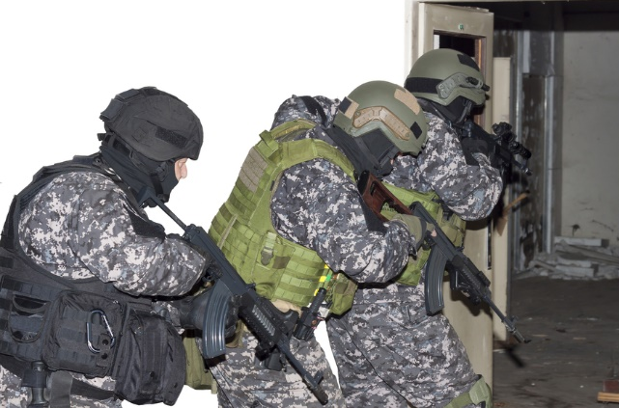
Dynamic Entry
Relies on surprise, speed and domination by force
attempts to surprise, disorient and overwhelm the target, allowing officers to gain control of the situation before anyone can resist or destroy evidence
May include use of noise-flash devices to create confusion and diversion

Slide 26
Dynamic Entry
Is most appropriate when there is an active threat of imminent loss of life
hostage rescue, active shooter, etc.
Is not appropriate if the target is prepared for engagement
Requires extensive coordination among team members and efficient execution
errors pose serious dangers

Slide 27
Deliberate Entry
Involves methodical entry, typically with less noise and violence than dynamic entry
allowing more time for officers to process details of the situation and react appropriately
May include use of surveillance tools such as corner mirrors, robotic cameras, etc.

Slide 28
Deliberate Entry
Is used to try to reduce the distance between officer and threats before engagement
Is most appropriate in the following circumstances:
when the exact location of a target within the building is unknown
when entry team is limited or not familiar with dynamic tactics

Slide 29
Ruse Entry
Is the use of a deceptive, non-threatening individual during approach in order to get the target to open a point of entry
for example, an officer acting as a delivery or maintenance man and knocking on the door
Can be difficult due to the following:
need for inconspicuous set up
difficult transition from ruse to search and clear

Slide 30
Ruse Entry
Is appropriate when breaching the building poses too many risks
for example, when there are many innocent bystanders in the building
Is not appropriate in barricaded situations
Involves less safety risk, but is somewhat controversial and more likely to be challenged in court
Breach – to break into or through

Slide 31
Breaching
Is often required in tactical entry
Is the process of breaking into or through by force
Location and method must be determined during planning
alternates should also be selected
choices should be made based on mission, building characteristics and personnel and equipment available

Slide 32
Breaching
Locations are countless
doors, windows and even walls
Requires team members line up in the proper order for entry and arrive at the breach point undetected
Includes five methods:
manual
mechanical
ballistic
explosive
thermal

Slide 33
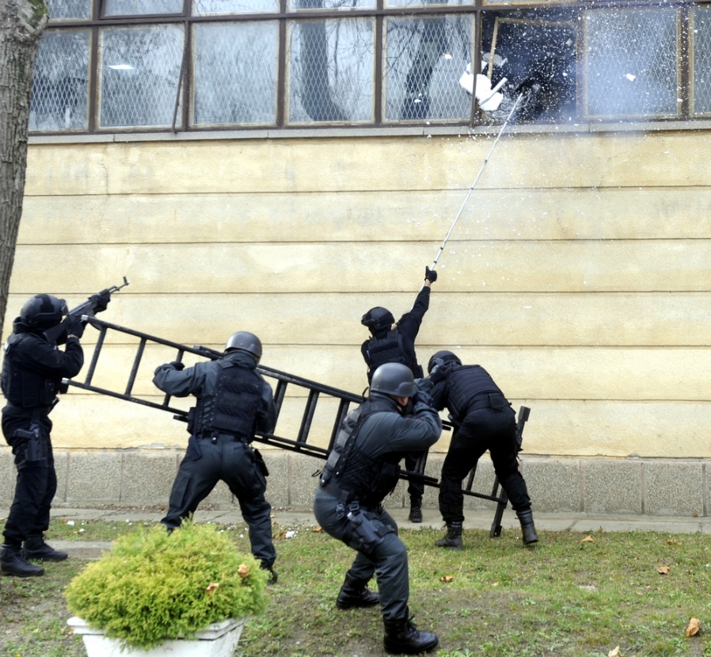
Manual Breaching
Relies on brute force created by tactical team members
Includes the use of manual tools
battering rams
pry bars
sledge hammers
axes
bolt cutters
keys

Slide 34
Mechanical Breaching
Employs the use of pneumatic, hydraulic and electric tools including:
reciprocating saws
chain saws
Jaws of Life®
hydraulic rescue cutters, spreaders and rams

Slide 35
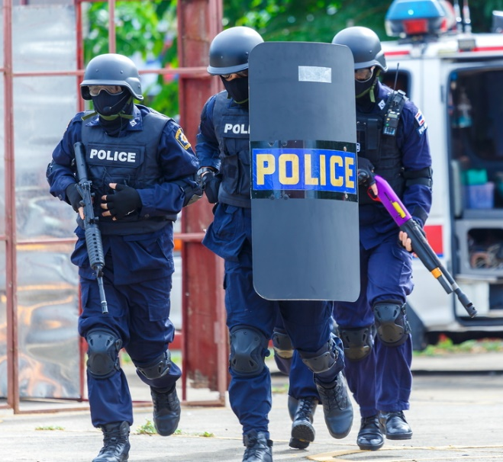
Ballistic Breaching
Describes when a shotgun is fired strategically at the door to break it open
locking and latching mechanisms or hinges
Utilizes specialized 12-gauge door-breaching rounds
using standard shotgun rounds can result in over-penetration or ricochet
Ricochet – shot or hit which rebounds off a surface

Slide 36
Explosive Breaching
Utilizes explosive charges placed strategically at intended point(s) of entry
types of explosives used include detonating cord and plastic explosives, such as C-4
Involves the tactical team being at a distance or behind cover
Requires more training and expertise than manual and mechanical breaching
therefore, it is not as common

Slide 37
Thermal Breaching
Describes when a cutting torch is used to burn through steel doors, hatches or walls
Requires extensive training and specialized equipment
making it the least used method of entry

Slide 38
Door Entry Techniques
Should allow officers to maintain tactical angles to areas which might contain a target, known as unclear areas
once an area has been searched and no targets are present, it is considered clear
Should keep officers moving to avoid stalling in the “fatal funnel”
cone-shaped path from the doorway or entry into the room
will likely be the focal point of attention by targets anticipating police arrival

Slide 39
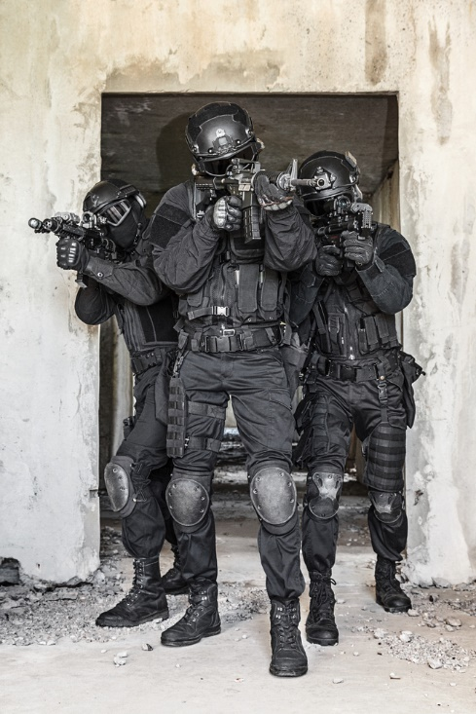
Door Entry Techniques
Include:
crisscross
buttonhook
combination

Slide 40
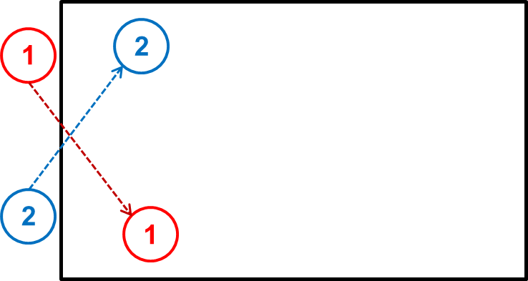
Crisscross Entry
Has officers move in a straight line diagonally through the entry, with officers coming from opposite sides

Slide 41
Crisscross Entry
Advantages include:
officers can see more of their area before entering and immediately upon entry
Disadvantages include:
takes longer for all officers to enter
if timing is off, officers may be in each other’s way

Slide 42
Buttonhook Entry
Has officers quickly round each side of the doorway

Slide 43
Buttonhook Entry
Advantages include:
two officers can enter simultaneously
considering most door sizes
Disadvantages include:
officers are blind to their areas before entering

Slide 44
Combination Entry
Has officers alternating crisscross and buttonhook entry methods
2
2
1
1

Slide 45
Combination Entry
Advantages include:
flexibility
gaps left by mistakes are more easily filled
more difficult for targets to predict
Disadvantages include:
requires more coordination among team members

Slide 46
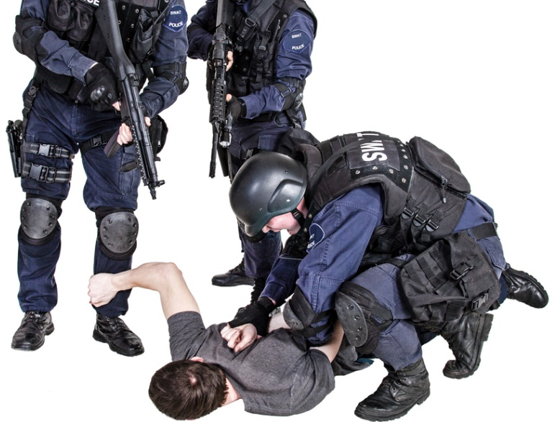
Alternatives to Tactical Entry
May be preferable depending on the mission and risks
Include:
takedown
stake out building and wait until target exits to perform arrest
surround and call out
cover all exits and command target to come out peacefully

Slide 47
Searching and Clearing

Slide 48
Searching
Is the process of looking for targets, threats, hostages, bystanders, etc.
Requires officers be thorough, patient and systematic
look at every possible hiding location
allows the time necessary to absorb and process the details of observations
select and utilize a system to avoid missing anything

Slide 49
Clearing
Is the process of verifying a space is not occupied by a threat
Requires neutralizing any threats found
taking suspects into custody
disabling booby traps, bombs, etc.
containing toxic materials
drugs, chemicals, etc.

Slide 50
Searching & Clearing
Should be performed in teams
ideal number depends on the situation, but at least two officers are necessary
so one can search while the other provides cover
Includes use of numerous techniques and formations, which should be planned based on the following:
mission and risks
layout of building
arrangement within each room
personnel and equipment available

Slide 51
Searching & Clearing
Should follow these guidelines:
team members should know their exact roles
communication among team members is important, but officers must ensure it does not provide targets information
hand signals are commonly used
officers should maintain proper shooting form and keep their firearms in a ready position whenever possible

Slide 52
Searching & Clearing
Should follow these general steps:
enter quickly
avoid becoming stalled in the “fatal funnel”
clear the nearest corner of the room
handle nearest threats first
continue along the wall, scanning the area until meeting another officer where his area meets yours
moving as necessary to see around and behind any furniture or other obstructions
moving at a speed which is quick but allows for accurate engagement if necessary

Slide 53
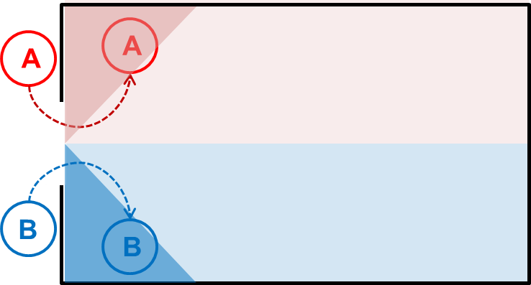
Searching & Clearing
For example:
step 1: dotted line indicates path
step 2: triangle indicates corner cleared
step 3: rectangle indicates area cleared

Slide 54
Searching & Clearing
Requires officers communicate when a room or area is clear
communication technique should be planned and depends on the situation
verbally stating “clear”
using nonverbal hand signals
using visual markers such as spray paint or ribbon

Slide 55
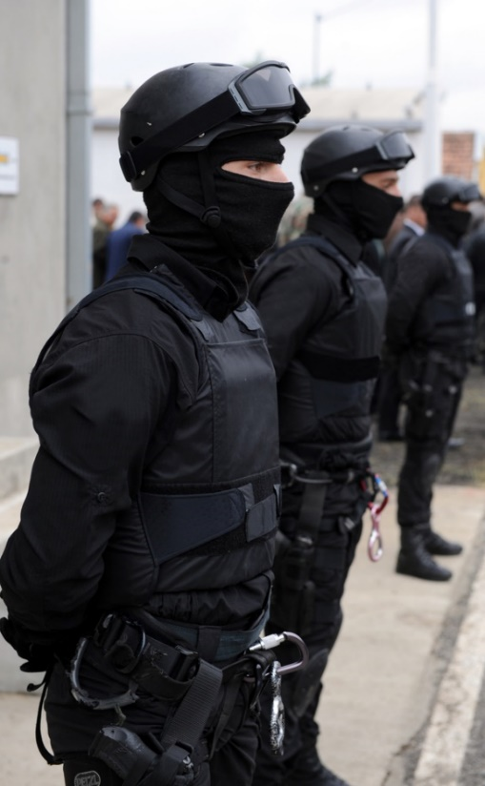
Security
Is vital after a room or building has been cleared to ensure threats do not re-enter the space
evacuate any wounded
provide separate space for hostages, witnesses, etc.
post security officers at all entrances

Slide 56
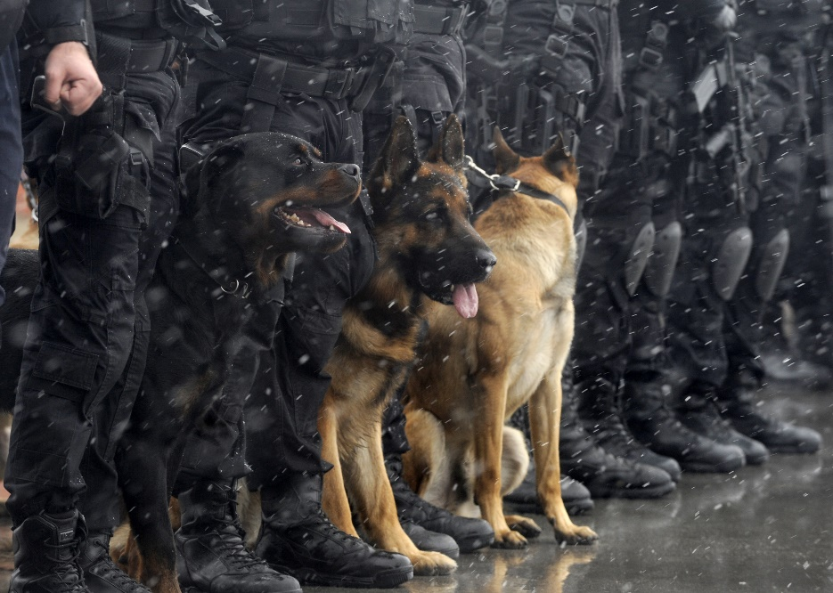
Searching & Clearing Tools
May be used to lessen the danger to officers
Include:
flashlights
corner mirrors
night-vision devices
thermal vision devices
robotic cameras
canines (dogs)

Slide 57
Play iCEV Video
Teacher Instructions:
Show the Procedures video segment

Slide 58
Resources
https://www.policeone.com/swat/articles/2154851-Dynamic-entry-versus-deliberate-entry/
http://www.tactical-life.com/tactics/breach-entry-tactics/#breach-entry-gwle-buffalo-bill
http://www.policemag.com/channel/patrol/articles/2014/02/constitutional-home-entry.aspx
https://www.policeone.com/police-products/training/articles/1243796-Tactical-decision-making-An-equation-for-critical-thinking-in-moments-of-crisis/
http://www.policemag.com/blog/training/story/2013/05/starting-a-tactical-team-setting-goals.aspx
http://www.cqb-team.com/tactical_trainer.php
http://www.officer.com/article/10248643/the-abcs-of-ppe
https://www.policeone.com/explosives-eod/articles/171622006-Breaching-Which-option-is-best-for-your-team/
https://www.policeone.com/swat/articles/6806339-Building-entries-Fusing-dynamic-with-deliberate/

Slide 59
PowerPoint® Acknowledgements
V.P. of Brand Management
Clayton Franklin
Executive Producer
Gordon W. Davis, Ph.D.
Brand Manager
Amy Hogan
Graphics Editor
Melody Rowell
Quality Control Director
Angela Dehls
© MMXVIII
CEV Multimedia, Ltd.

Slide 60
Video Acknowledgements
Collaborator
Steve Denton, Corporal (Retired)
Baytown Police Department
Special Thanks
Mont Belvieu Police Department
Mont Belvieu, Texas
Gary P. Cochran, Police Captain (Retired)
149th F.B.I.N.A.
V.P. of Brand Management
Clayton Franklin
Executive Producer
Gordon W. Davis, Ph.D.
Brand Manager
Amy Hogan
Graphics Editor
Melody Rowell
Videography
Pamela Hester
Video Post Production
Mike Barley
Quality Control Director
Angela Dehls
© MMXVIII
CEV Multimedia, Ltd.

