Slide 1
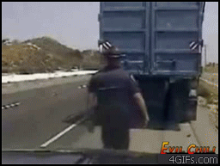
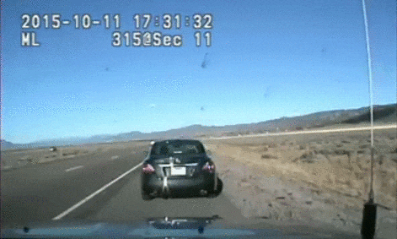
Traffic Stops

Slide 2
Traffic Stops Introduction
Traffic stops are a huge component of daily duties for police officers and one of the most dangerous and unpredictable situations
It is important that officers recognize the inherent danger that can erupt at any moment during a stop
There is no routine traffic stop

Slide 3
What are some dangerous situations that can happen during a traffic stop?
Notes:
🍐 This is a Pear Deck Text Slide
🍐 To edit the type of question, go back to the "Ask Students a Question" in the Pear Deck sidebar.

Slide 4
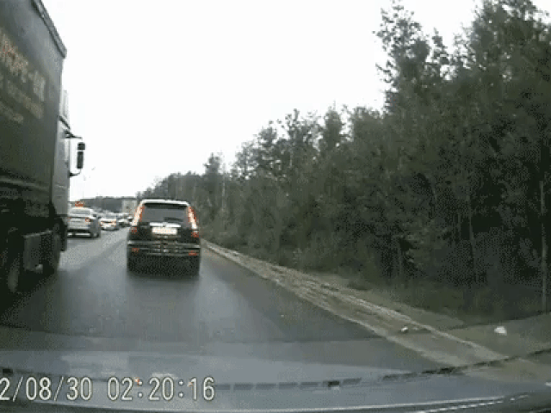
Transportation Code Violations
Most traffic stops originate in someone, the police officer or a civilian, witnessing a violation of the Texas Transportation Code
To write a citation, the police officer needs to personally witness the violation
Examples?
Notes:
Speeding on the highway
Car matches description of stolen vehicle
911 caller reports reckless driver
Theft of gas with description and plates of vehicle
Car swerving outside of single lane
Driver throws cigarette out window
Headlight out at nighttime

Slide 5
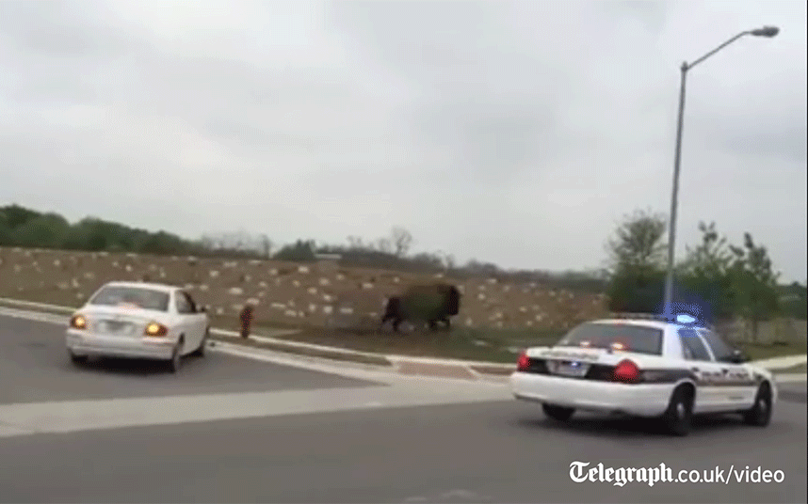
Other Reasons for Traffic Stops
There are many other reasons to stop a vehicle besides a Transportation Code violation. They include:
Reasonable Suspicion Stops
Suspicious persons at suspicious places and times
Investigatory Stops
Person driving is a witness to a crime
Community Care Stops
Someone is driving in circles and appears lost
A person is broken down on the side of the road
For the sake of brevity, we will focus on basic traffic stops due to a visible violation of the Transportation Code

Slide 6
Traffic Stop Initiation
Once a violation is witnessed the officer should contact dispatch
Provide dispatch with vehicle information (see example slide)
After receiving the return from dispatch, the officer then turns on the overhead lights and initiates the stop in a safe location.
From this point forward, watch all movement in the car for unusual/furtive movement; if something feels out of place call for backup.
Provide dispatch with location of the stop (see example slide)

Slide 7
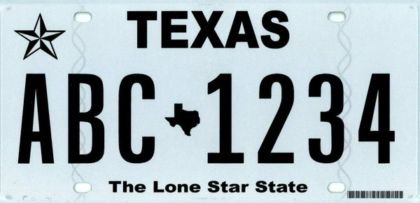
How to Provide Dispatch with License Plate Number & Vehicle Description
Plate ID using phonetic alphabet (repeat)
Color, make and model of vehicle
Number of occupants in the car if known
Run for stolen through TCIC/NCIC
Against the wanted persons database
Against vehicle registration database

Slide 8
What is TCIC/NCIC?
TEXAS CRIME INFORMATION CENTER
NATIONAL CRIME INFORMATION CENTER
COMPUTERIZED DATABASES OF CRIMINAL JUSTICE INFORMATION AVAILABLE 24/7, 365 DAYS A YEAR
Wanted Person (warrants)
Stolen Property
Missing Persons
Criminal History
Gang Affiliation
Sex Offender Registry
Immigration Violators
Suspected Terrorist

Slide 9
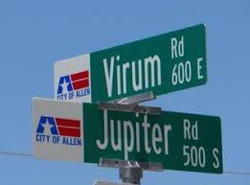
How to Provide Location of the Stop to Dispatch
Dispatch already knows you are working a possible traffic stop…
“583 to dispatch”
Wait for dispatch to acknowledge
“Initiating traffic stop at Virum & Jupiter”
You can provide a cross street like this example
You can provide a street name and block (ex. Initiating stop
in the 300 block of Rivercrest Blvd)
You can provide an identifying location (ex. Initiating stop
in the parking lot of Walmart on West Exchange)

Slide 10
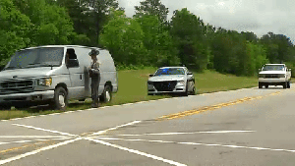
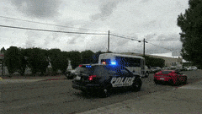
Vehicle Positioning
When you pull over a vehicle, you’ll want to position the patrol vehicle one-two car lengths behind and slightly to the left
It provides cover in case of gunfire
Always check for traffic before you get out and during your traffic stop!!
Drunk drivers are attracted to your lights and can veer straight into you, the patrol vehicle or the stopped vehicle

Slide 11
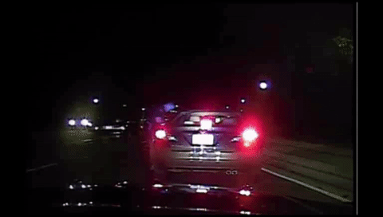
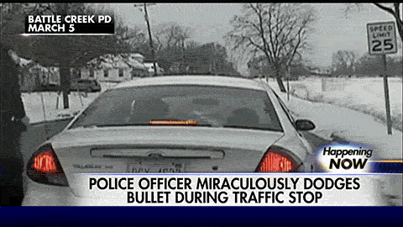
The Approach
After checking for oncoming traffic, exit the patrol vehicle
The police officer can approach either driver side or passenger side
If you’re on a busy highway with a speed limit 50+ mph, a passenger side approach is safer
Make certain to close the patrol vehicle door quietly (do not slam)
Touch the tail lights, leaving your fingerprints, and quickly check that the trunk is closed by placing your hand on it as you walk to the window to make contact

Slide 12
Do Not Slam the Patrol Unit Door
WHY?
Notes:
🍐 This is a Pear Deck Text Slide
🍐 To edit the type of question, go back to the "Ask Students a Question" in the Pear Deck sidebar.

Slide 13
Vehicle & Officer Positions

Slide 14
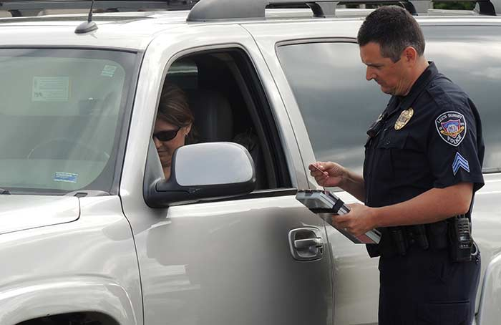
Use the door post as cover
while talking to the driver
What do you notice about the way the officer is positioned/standing?
Notes:
🍐 This is a Pear Deck Text Slide
🍐 To edit the type of question, go back to the "Ask Students a Question" in the Pear Deck sidebar.

Slide 15
Stand at an Advantageous Position
BLADED STANCE

Slide 16
Nighttime Approach
At night time you will use your lights for tactical advantage
Engage your:
Take down lights
Spotlight shine on driver side mirror
You can use your flashlight to illuminate the interior of the vehicle to check for contraband, weapons are individuals that may be hiding.

Slide 17
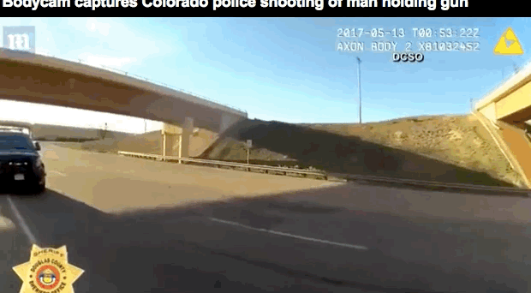
Safety Considerations
When walking to and from the patrol car...
There are 2 methods an officer can use:
Walking Backwards from the stopped vehicle
Take care not to trip/fall and watch for oncoming traffic
Walking Normal back to your patrol vehicle
Walking with your back to the stopped vehicle
If you use this method, look over your shoulder so you can see if they jump out or furtive movements occur
***Always make sure the hands of all occupants are in view***
If you can not see them, ask them to put their hands on the steering wheel

Slide 18
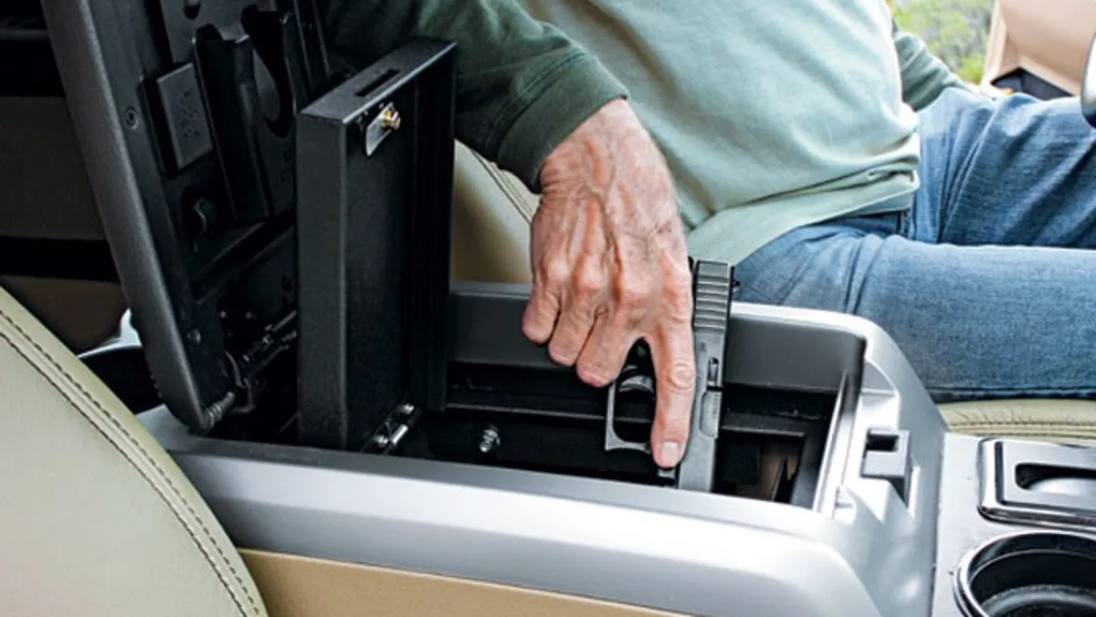
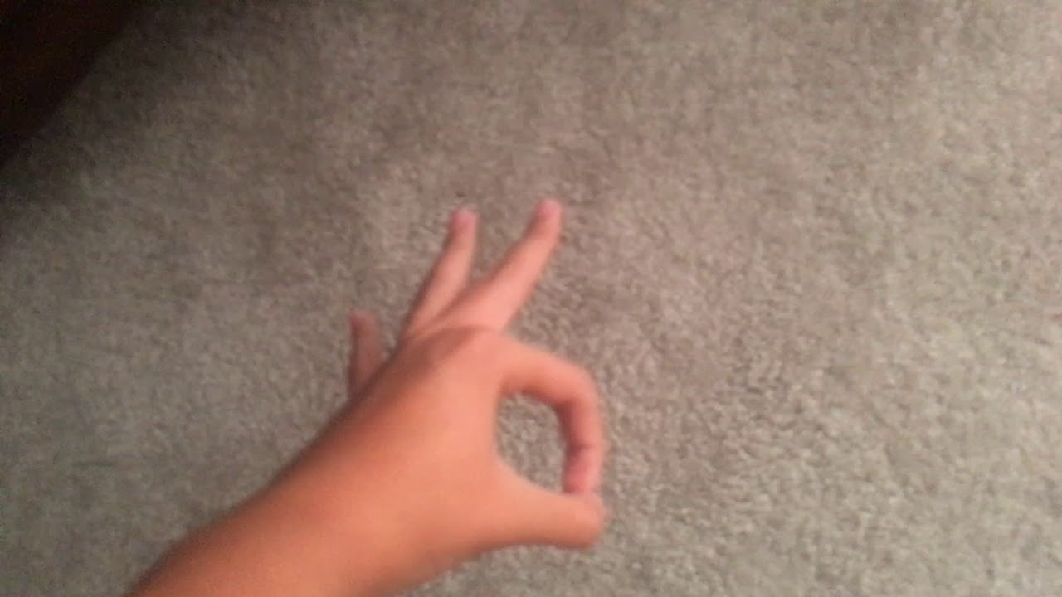
Why is it important for the hands to be visible at at all times?
Notes:
🍐 This is a Pear Deck Text Slide
🍐 To edit the type of question, go back to the "Ask Students a Question" in the Pear Deck sidebar.

Slide 19
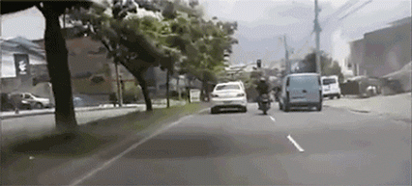
7-Step Violator Contact Method
Most traffic stops will follow the 7-Step Violator Contact method:
1) Greet and Identify
2) State the Violation
3) Ask for ID/Insurance
4) State the Action to be Taken
5) Take the Action
6) Explain what the Violator must do
7) Leave

Slide 20
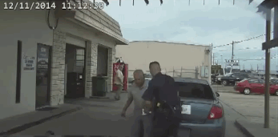
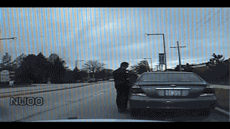
Greetings & Violations
1) Greeting
Do it in the most natural way for the officer
Identify yourself and your agency
Be polite, you catch more flies with honey than vinegar
2) Statement of Violation Committed
Uses “you” rather than “I”
Places the action on the driver and not the officer
States exactly what they did wrong and where
Exact speed clocked on radar and speed limit given
Asks “is there any reason you were going that fast?”
Allows driver to explain if there is an emergency

Slide 21
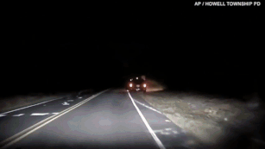
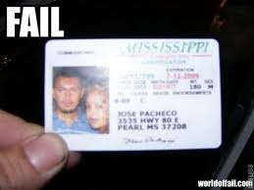
Identification of Driver
3) Identification of Driver
The most important step is to identify the driver
There are multiple methods:
Driver’s license from any state
Name and Date of Birth
Passport number
Identification card/DL from another country
***Note, it might be difficult and time consuming to get back returns on international persons***
To identify other people in the car, you can ask for identification but they do NOT legally have to provide it; at this point use your verbal skills to convince them to give you an ID or Name/DOB
Insurance can be verified through dispatch if they do not have it

Slide 22
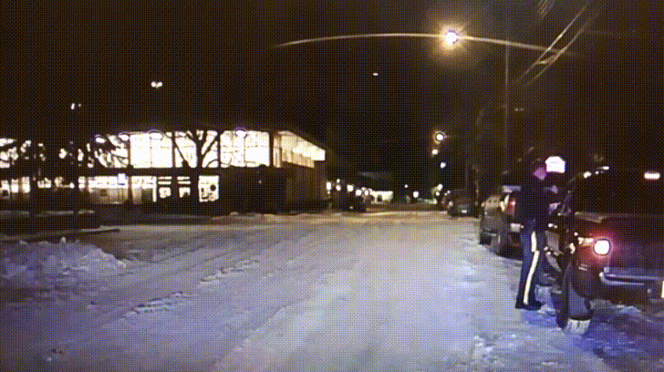
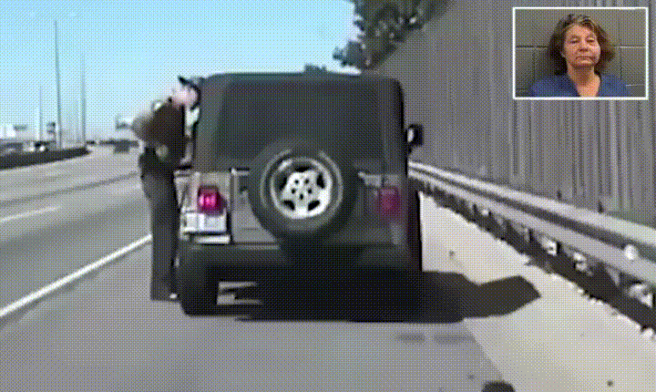
Statements & Actions
4) Statement of Action Taken
Tell the driver what action you plan on doing before returning to the vehicle:
Written warning
Citation
5) Take that action
The Sandra Bland Act requires all traffic stops to be documented as of January 1, 2018 including “verbal warnings” so the majority of police departments are doing written warnings
New policy of recording if physical force was used during the stop
Record all information on driver & vehicle
Fill out the appropriate boxes on race information, searches & contraband
Remember to frequently look at the vehicle and occupants!!!

Slide 23
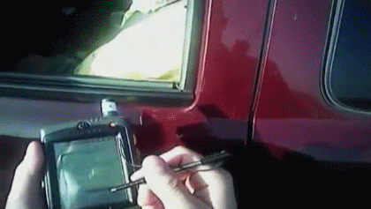
Explanation & Safe Departure
6) Explanation of what Violator Must Do
For citations and written warnings, you will need to get a driver signature
For citations:
Say This is not a guilty plea, this is a promise to appear in court or pay by this date
Give the next available court date for citations (also written on citation)
Violators must have at least 10 working days from the date of the stop until the court date
Drivers must pay before the court date or show up to court
Give the driver the court paperwork for information on how to pay and a copy of their citation
For written warnings:
Give a copy of the written warning and tell them they do not have to do anything (court/pay)
Return all Driver’s licenses and tell them they are free to go at this point
7) Safe Departure
Walk back to the car, checking for traffic and keeping an eye on the driver
Turn off overhead lights, car & body camera, and radio dispatch you are 10-8

Slide 24
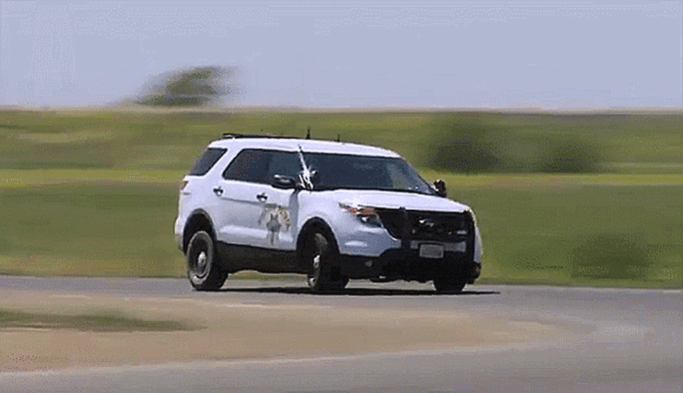
Warrants
Dispatch will check for warrants of every driver license/name given
If there’s an active warrant, dispatch will say 10-99
Dispatch will have to confirm there is a warrant and that the agency with the warrant will extradite the person
Some warrants are only good within 150 miles of the county of the agency
Some warrants are only good in that state
Some agencies only arrest for warrants if it is over $500 in fines
If the person has a warrant and it is confirmed, the person is placed under arrest and booked in the nearest county jail
If the warrant is non-extradition, do not tell the person they have a warrant
They might kill/run from/assault the next officer who pulls them over

Slide 25
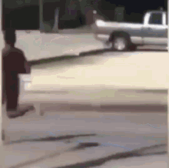
Special Circumstances
If an officer makes contact with the violator and:
Smells marijuana or sees contraband in plain view
The officer may conduct a probable cause search for drugs
Ask the driver to step out of the vehicle and pat them down for weapons
Repeat for all other passengers, get them out and pat them down
Search the vehicle for contraband
Sees a Gun on the front seat
Radios for backup, can draw gun from holster; keeps at the side
Can leave it there, order from car, or place in handcuffs depending on the situation
Driver hands the officer his/her Concealed Handgun License (CHL)
Officer asks for location of handgun, tells driver to keep hands on steering wheel
Driver exits vehicle
Orders driver back in, uses appropriate level of force if driver refuses

Slide 26
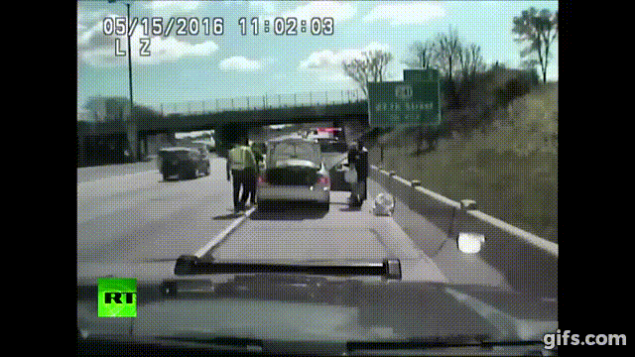
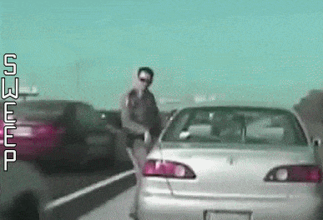
Professionalism
Remember to always act professional and remember you are on video
Some drivers will be angry, scared or rude as well as trying to get a rise out of you
More than a normal amount of fear or nervousness is a cause for caution
There may be drugs, guns, or a warrant on the driver
Do NOT use more than the appropriate level of force
Do NOT react to someone baiting you or insulting you
Do NOT get into an argument with the driver
If the person continues to argue, hand them their citation and walk away

