Slide 2
Objectives
To explore terminology employed in the criminal justice system.
To identify vocabulary used by professionals in law enforcement, court systems, corrections and security.

Slide 3
Criminal Justice
Is the system of agencies and practices established by governments to uphold social order, deter and mitigate crime and impose penalties on those who violate laws
Systems include:
law enforcement
courts
corrections
security

Slide 4
Criminal Justice
Systems use specific terms to identify processes, procedures and policies
these terms can be confusing to those without knowledge of their meanings
understanding these terms is crucial to effective communication

Slide 5
Law Enforcement
Consists of systems which enforce the law by:
deterring law violations
discovering law violations
apprehending and detaining individuals who violate laws

Slide 6
Law Enforcement
Terminology includes:
Term | Definition
accessory | a person who is not the chief offender but is involved in some way; accomplice or abettor
admission | voluntary acknowledgement of certain facts
aggravation | behavior accompanying a crime which increases its intensity or adds to its consequences beyond what is necessary for the commission of the crime itself
arson | deliberately and illegally setting fire to a property
assault | attempting or threating to inflict bodily injury

Slide 7
Law Enforcement
Terminology includes:
Term | Definition
back up | officers who assists first responders
battery | causing bodily harm or offensive physical contact
beat | area an officer is assigned to patrol
burglary | entering a property or room with the intent to steal items from the premises
civil action | lawsuit brought to redress a private issue (as opposed to a crime)
confession | admission of enough facts to establish guilt of a particular crime

Slide 8
Law Enforcement
Terminology includes:
Term | Definition
conspiracy | agreement between two or more people to commit a crime
controlled substance | drug or substance regulated by federal or state law
detective | officer of the law responsible for investigating crimes (rather than patrolling or responding)
extradition | process by which a state or nation transfers custody of an individual for prosecution or punishment
frisk | limited protective search of a person consisting of a pat down of outer clothing

Slide 9
Law Enforcement
Terminology includes:
Term | Definition
homicide | unlawful killing of a person by another person; includes murder and manslaughter
jurisdiction | legally defined area over which an agency has control
juvenile | person less than 18 years old; also known as a minor
juvenile delinquent | juvenile who habitually violates the law
lockup | temporary detention facility

Slide 10
Law Enforcement
Terminology includes:
Term | Definition
manslaughter | unlawful killing of a person without malice
murder | unlawful killing of a person with malice
probable cause | facts and circumstances providing reasonable justification for an seizure, search or warrant
reasonable suspicion | facts and circumstances providing justification for a brief stop or detention; less than probable cause, but more than a hunch or mere speculation
robbery | theft of property from a person using force or the threat of force

Slide 11
Law Enforcement
Terminology includes:
Term | Definition
sheriff | elected chief officer of a county law enforcement agency
statute of limitations | restriction setting the period of time allowed to elapse between the occurrence of an incident and the filing of a lawsuit or criminal prosecution
warrant | written order issued by a judge directing an officer to perform an arrest, search or seizure

Slide 12
Law Enforcement
Abbreviations include:
Abbreviation | Definition
AAG | Assistant Attorney General
ADW | assault with a dangerous/deadly weapon
AKA | also known as
A/O | arresting officer
APB | all-points bulletin; similar to BOLO
BAC | blood alcohol concentration
B&E | breaking and entering
BOLO | be on the lookout; similar to APB

Slide 13
Law Enforcement
Abbreviations include:
Abbreviation | Definition
CI | confidential informant
CODIS | combined DNA index system
CPS | Child Protective Services
DOA | dead on arrival
DOB | date of birth
DUI | driving under the influence
DWI | driving while intoxicated/impaired
GSR | gunshot residue
Interpol | International Criminal Police Organization

Slide 14
Law Enforcement
Abbreviations include:
Abbreviation | Definition
K9 | canine (dog)
LKA | last known address
MO | modus operandi (Latin for method of operation); pattern of behavior typical for a particular offender committing a specific crime
OD | overdose
PI | private investigator
SSN | Social Security number
SWAT | Special Weapons and Tactics

Slide 15
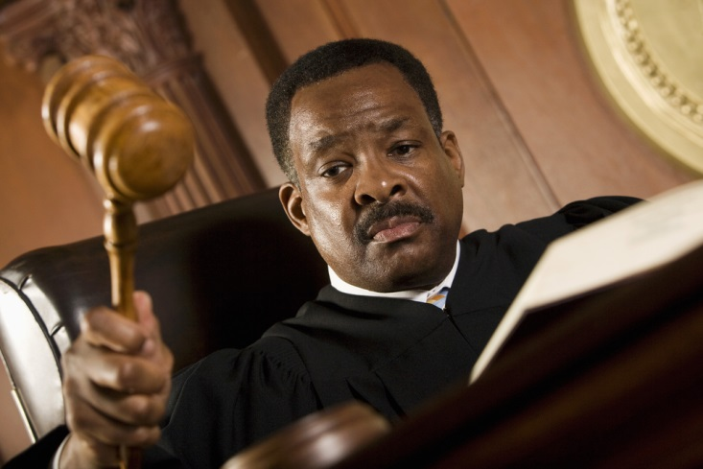
Courts
Are systems which interpret and apply laws by:
hearing cases
verifying evidence and facts of cases
determining how the law applies to any given situation
making decisions regarding fault and punishment

Slide 16
Court
Terminology includes:
Term | Definition
acquittal | legal judgment stating a person accused of a crime cannot be found guilty beyond a reasonable doubt
adjudication | any judicial decision ending a criminal proceeding (acquittal, conviction or dismissal)
affidavit | written, sworn statement
appeal | request by defense or prosecution to have a higher court resolve a dispute with a decision
arraignment | hearing in which a person charged with a crime is informed of the charges, enters a plea and is advised of constitutional rights

Slide 17
Court
Terminology includes:
Term | Definition
bail | release, prior to trial, of an accused person under certain conditions; also refers to the money provided as a condition of release
bench trial | trial in which a judge hears the case and decides guilt of the accused without a jury
burden of proof | threshold which must be reached in order to have a claim legally established as fact
case law | law formed by past court decisions
charge | formal accusation filed by prosecution

Slide 18
Court
Terminology includes:
Term | Definition
class action | civil lawsuit in which a large group sues
clemency | reduction of the sentence of a convicted criminal
continuance | delay or postponement of a court hearing
conviction | legal judgment stating a person accused of a crime has been found guilty
cross examination | process of a witness being questioned by the opposing party
defendant | party against whom a claim or charge is brought

Slide 19
Court
Terminology includes:
Term | Definition
deposition | sworn testimony of a witness taken outside of court in the presence of prosecution and defense attorneys
disposition | final judicial decision
hung jury | jury unable to reach a verdict because of disagreement
indictment | formal accusation initiating a criminal case
mistrial | trial deemed invalid because of a fundamental error in procedure, such as misconduct or a hung jury

Slide 20
Court
Terminology includes:
Term | Definition
motion | formal request made to a judge for an order or judgment
objection | protest or argument made concerning the activity of the opposing party in court
plaintiff | person or party who initiates a lawsuit
plea | formal statement made by or on behalf of a defendant stating guilt or innocence in response to a charge
plea bargain (agreement) | agreement between defendant and prosecutor where defendant agrees to plead guilty in exchange for concessions

Slide 21
Court
Terminology includes:
Term | Definition
preliminary hearing | legal proceeding to determine if there is sufficient probable cause to hold the accused for trial
pro se | when a defendant represents him or herself rather than having a defense attorney
prosecutor | government attorney who represents the interests of the public in court proceedings against people accused of crimes
recusal | when a court official disqualifies or withdraws him or herself from a case due to questions regarding bias

Slide 22
Court
Terminology includes:
Term | Definition
restitution | compensation a convicted offender is ordered to pay to the victim
subpoena | court order requiring a person to appear in court to give testimony or provide evidence
summons | court order requiring an accused person (who is not already in custody) to appear in court
testimony | formal statement given by a witness under oath
voir dire | procedure in which the prosecutor and defense attorney question potential jurors to pick a jury

Slide 23
Court
Abbreviations include:
Abbreviation | Definition
AAG | Assistant Attorney General
A.L.R. | American Law Reports (followed by number to denote edition, e.g. A.L.R. 4th)
C.F.R. | Code of Federal Regulations
C.J.S. | Corpus Juris Secundum (encyclopedia of law)
F. | Federal Reporter (followed by number or letters to denote edition, appendix, etc., e.g. F.3d or F. App’x)
F.R.D. | Federal Rules Decisions

Slide 24
Court
Abbreviations include:
Abbreviation | Definition
Fed. R. Civ. P. | Federal Rules of Civil Procedure
Fed. R. Crim. P. | Federal Rules of Criminal Procedure
Fed. R. Evid. | Federal Rules of Evidence
M.J. | West’s Military Justice Reporter
Stat. | United States Statutes at Large
U.S. | United States Reports
U.S.C. | United States Code
Vet. App. | West’s Veterans Appeals Reporter

Slide 25
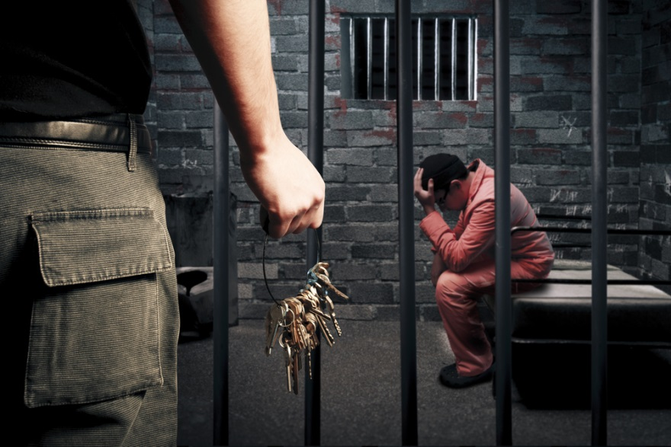
Corrections
Are systems responsible for the punishment and supervision of convicted criminals
through incarceration
through rehabilitation

Slide 26
Corrections
Terminology includes:
Term | Definition
absconder | person on parole who fails to report to his or her parole officer
capital punishment | legally authorized killing of a convicted offender as punishment for a crime
chronic offender | person who persistently violates laws and has multiple arrests and convictions over an extended time
civilian staff | staff within a correctional facility who have no law enforcement authority

Slide 27
Corrections
Terminology includes:
Term | Definition
classification | process of determining type of housing and program access for a detainee or inmate by assessing risks of engaging in harmful behavior or being harmed while incarcerated
community corrections | component of correctional system offering viable alternatives to incarceration such as community service, probation, home confinement, etc.
community service | performance of labor or services in the public’s interest without pay as required by a sentence

Slide 28
Corrections
Terminology includes:
Term | Definition
concurrent sentence | prison terms for two or more convictions to be served simultaneously rather than one following the other
conditional release | release of a defendant while awaiting a court hearing granted on certain terms
consecutive sentence | prison terms for two or more convictions to be served one after another as opposed to simultaneously
contraband | prohibited item or substance which is smuggled into a correctional facility

Slide 29
Corrections
Terminology includes:
Term | Definition
detainee | person who is incarcerated while awaiting trial for an alleged crime
electronic monitoring | use of technological devices to supervise a person required to abide by conditions of release such as curfew or home confinement
good-time credits | days deducted from an inmate’s incarceration sentence for good behavior
home confinement | restriction of an offender to a certain residence for a specified period except during designated times for authorized activities

Slide 30
Corrections
Terminology includes:
Term | Definition
incarceration | confinement in jail or prison
inmate | individual convicted of a crime and committed to the custody of a jail or prison
jail | correctional facility typically run by local law enforcement and housing detainees and short-term inmates
parole | release of a prisoner from imprisonment, but not from legal custody and supervision

Slide 31
Corrections
Terminology includes:
Term | Definition
prison | correctional facility generally run by state or federal government and housing long-term inmates
private prison | prison owned and operated by a private company contracted by a federal or state correctional agency
probation | sentencing option in which the convicted offender is required to fulfill certain conditions
protective custody | segregation of a detainee or inmate within a correctional facility for his or her own safety

Slide 32
Corrections
Terminology includes:
Term | Definition
recidivism | tendency to relapse into criminal behavior
reintegration | process of helping an offender rejoin society and live as a law-abiding citizen
revocation | legal process in which an offender’s probation or parole is recalled because he or she fails to comply with the terms of release
sentence | sanction ordered by a court for a convicted offender

Slide 33
Corrections
Terminology includes:
Term | Definition
sworn staff | uniformed staff in a correctional facility who have law enforcement powers and receive training to meet state and agency standards
temporary-release program | program allowing inmates to leave the correctional facility for a short period to participate in approved activities
work release program | program in which detainees or inmates are permitted to be employed or participate in educational programs, but must return to the facility at the end of each work day

Slide 34
Security
Are systems focused on the protection of private property and people from assault, theft, vandalism, fire, etc.
provide guards and patrol services
install and maintain equipment used to secure and monitor property

Slide 35
Security
Terminology includes:
Term | Definition
alarm system | system of sensors, controls and annunciators arranged to detect and report an intrusion or other emergency
annunciator | device which announces an alarm via sound, light or other means
antivirus software | program which detects and removes computer viruses
armed | equipped with a firearm (gun)

Slide 36
Security
Terminology includes:
Term | Definition
armored car | armor-plated truck with strong locks and doors which is operated by armed personnel and used to transport currency and other valuables
asset | any property, tangible or intangible, which is owned by an individual or company and can be assigned a monetary value
background check/screen | inquiry into the history, behaviors and character of an individual
canned message | pre-recorded message to be used in case of an emergency

Slide 37
Security
Terminology includes:
Term | Definition
central command center | designated location from which security programs are monitored and emergency plans can be implemented
contact list | list of contact information for team members and key players needed in an emergency
critical control point (CCP) | site or stage at which controls can be applied to prevent or reduce a threat or hazard
damage assessment | process of evaluating injuries and loss of life, damage to property and status of facilities resulting from an emergency or incident

Slide 38
Security
Terminology includes:
Term | Definition
evacuation | planned, organized movement of people from a dangerous area
panic alarm (panic button) | device triggered by a person and designed to alert others (often authorities) in emergency situations
perimeter protection | safeguarding of a boundary
private sector | agency not under direct government control
proprietary information | valuable, private information created or collected for a considerable cost

Slide 39
Security
Terminology includes:
Term | Definition
residual risk | risk remaining after measures are taken to reduce or eliminate risk
silent alarm | device which, when triggered, alerts security personnel and/or police of a disturbance without the knowledge of the intruder or criminal
simulation exercise | test performed under conditions as close to as possible to real-world conditions
surveillance | direct and deliberate observation of people and/or property

Slide 40
Criminal Justice
Systems require effective communication for successful operation
miscommunication can have devastating effects
damage to property
injury to people
failure to apprehend or convict guilty individuals
charging or conviction of innocent individuals

Slide 41
Resources
http://mpdc.dc.gov/sites/default/files/dc/sites/mpdc/publication/attachments/Glossary%20of%20Police%20Terms%202013.pdf
http://www.safetyandjustice.org/files/CJ%20Glossary%20for%20web.pdf
http://www.bjs.gov/index.cfm?ty=tdtp&tid=7
http://www.uscourts.gov/glossary
http://www.discovercorrections.com/resources/glossary-of-terms
https://www.asisonline.org/Membership/Library/Security-Glossary/Pages/Security-Glossary.aspx

Slide 42
Acknowledgements
V.P. of Brand Management
Clayton Franklin
Executive Producer
Gordon W. Davis, Ph.D.
Production Coordinator
Amy Hogan
Graphics Editor
Melody Rowell
Quality Control Director
Angela Dehls
© MMXVII
CEV Multimedia, Ltd.

